Slide 1
Power Point #1
A Brief History of Patents in the United States
Power Point #2
Jonathan Hatch - Improvements in Fourdrinier Paper Making
Binns - Spiral Sewing Machine
Jillson and Palmer - Cotton Bale Opener
Hezekiah Conant- Spool Labeling Machine
#3 Patent History
Charles Barrows - Electric Bicycle, Train cars , Mustache Protecter Mug
E. Allen and A. Bradshaw- Moveable, Slidable Games
Catherine Griswold - 30 patents for Corset improvements
Jonathan Hatch - Collapsable Music Stand
Power point #4
Dr. Lee’s Bilious Pills
McCollum’s - Cracker Dough
Dr. George Hamlin - Cider
Ernest Chesbro - Sugar Crusher
Frederick Purington - Lock draw on Till

Slide 2
WINDHAM – WILLIMANTIC
PATENTS #3
History of Patents in the United States
Barrow’s Electric Bike, Train Car, Mustache Protector
Allen and Bradshaw’s Games
Griswold’s Corset Patents
Hatch’s Collapsable Music Stand
Funding provided by the CT Humanities
Inspired by the Connecticut Patent Project at the Connecticut State Library

Slide 3
The United States Patent Process
Exclusive commercial rights
A patent is a type of intellectual property that gives its owner the legal right to exclude others from making, using, or selling an invention for a limited period of time .
Patent pending- waiting for approval
Patent infringement – violation of patent holder’s rights

Slide 4
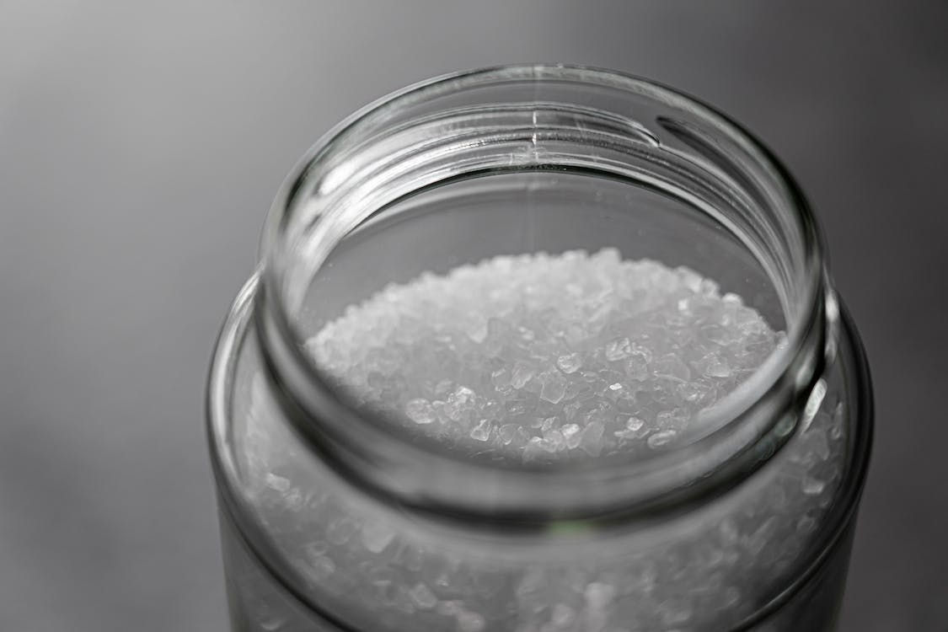
The 1st Patent (unofficially) 1641
The Massachusetts General Court gave Samuel Winslow an exclusive right to utilize a new process of making salt for 10 years.

Slide 5
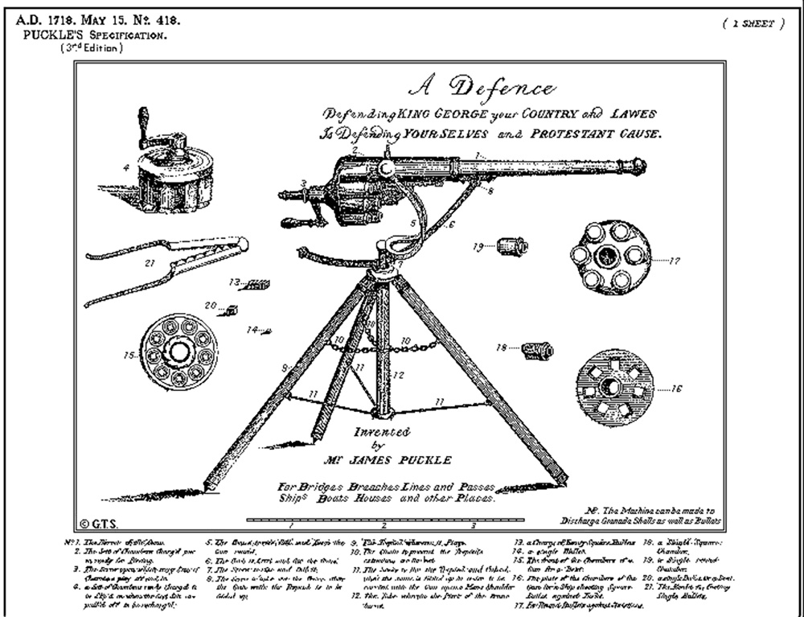
1718
James Puckle first specification drawing for a patent

Slide 6
The Constitution of the United States, first adopted on September 17, 1787, had a provision for protecting intellectual properties.
.
Article I, Section 8:
"The Congress shall have Power ... To promote the Progress of Science and useful Arts, by securing for limited Times to Authors and Inventors the exclusive Right to their respective Writings and Discoveries."

Slide 7
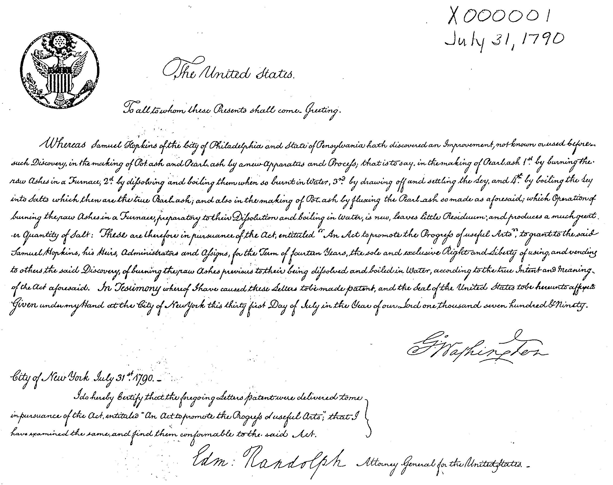
patent granted to Samuel Hopkins, VT for the "making of pot ash and pearl ash by a new apparatus and process".
(Potassium salts for fertilizer, lye and saltpeter)

Slide 8
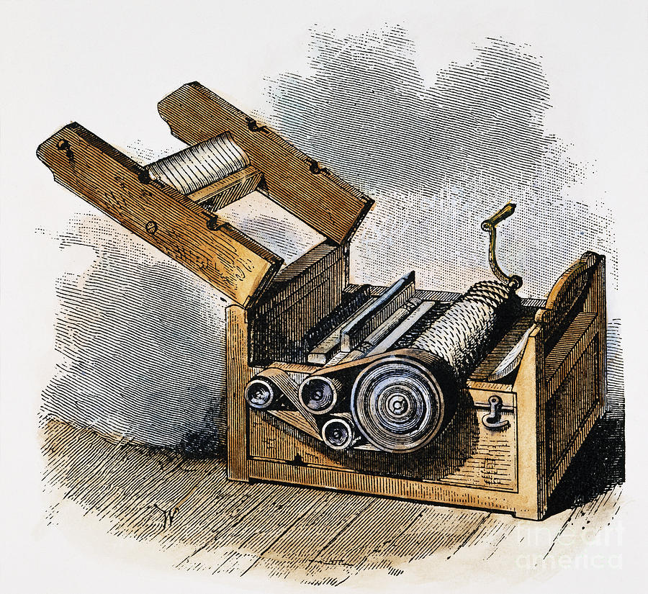
1794 cotton engine

Slide 9
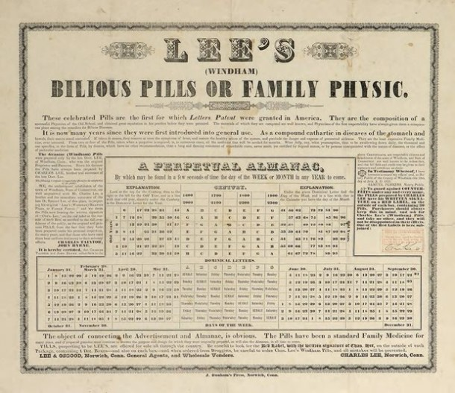
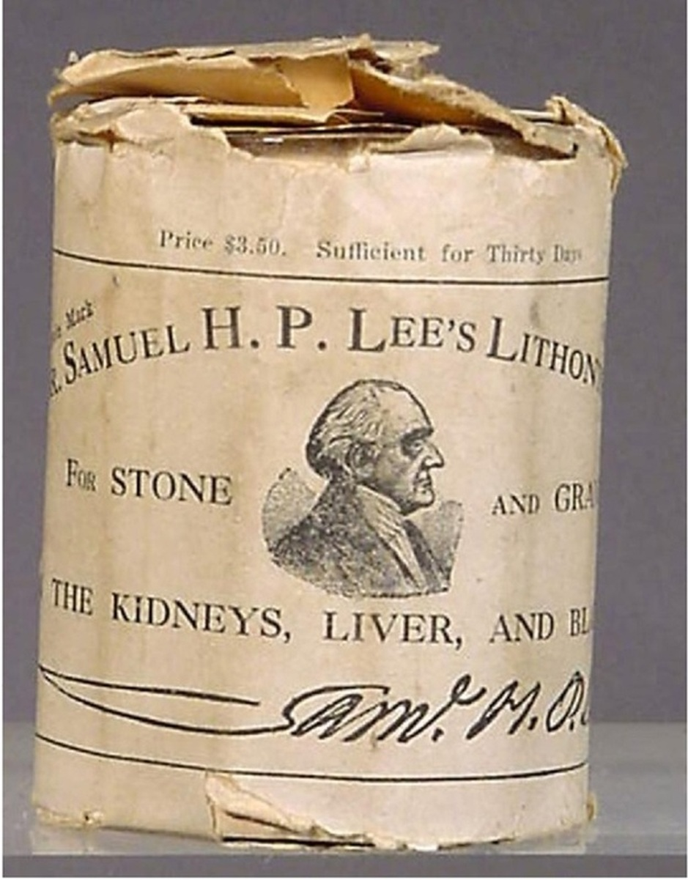
LEE’S WINDHAM BILIOUS PILLS

Slide 10
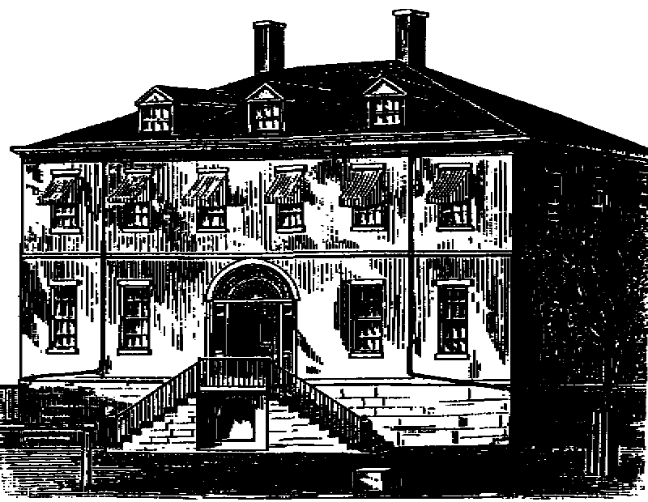
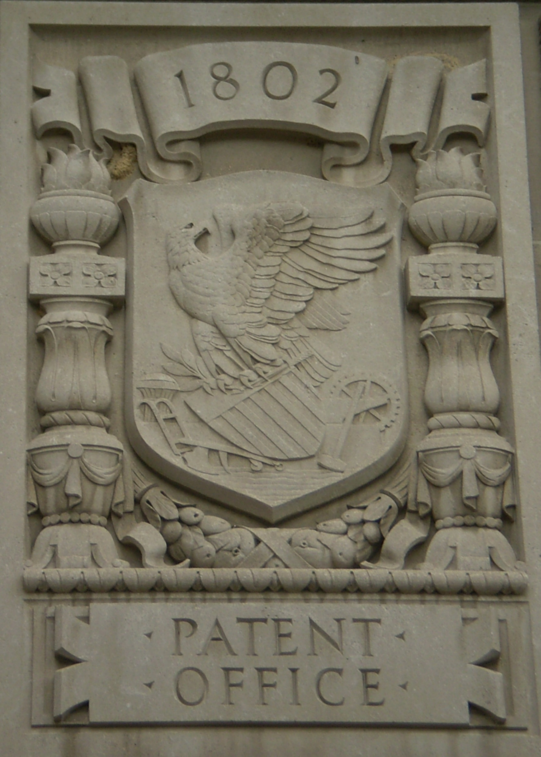
U.S. Patent Office
Burned 1836

Slide 11
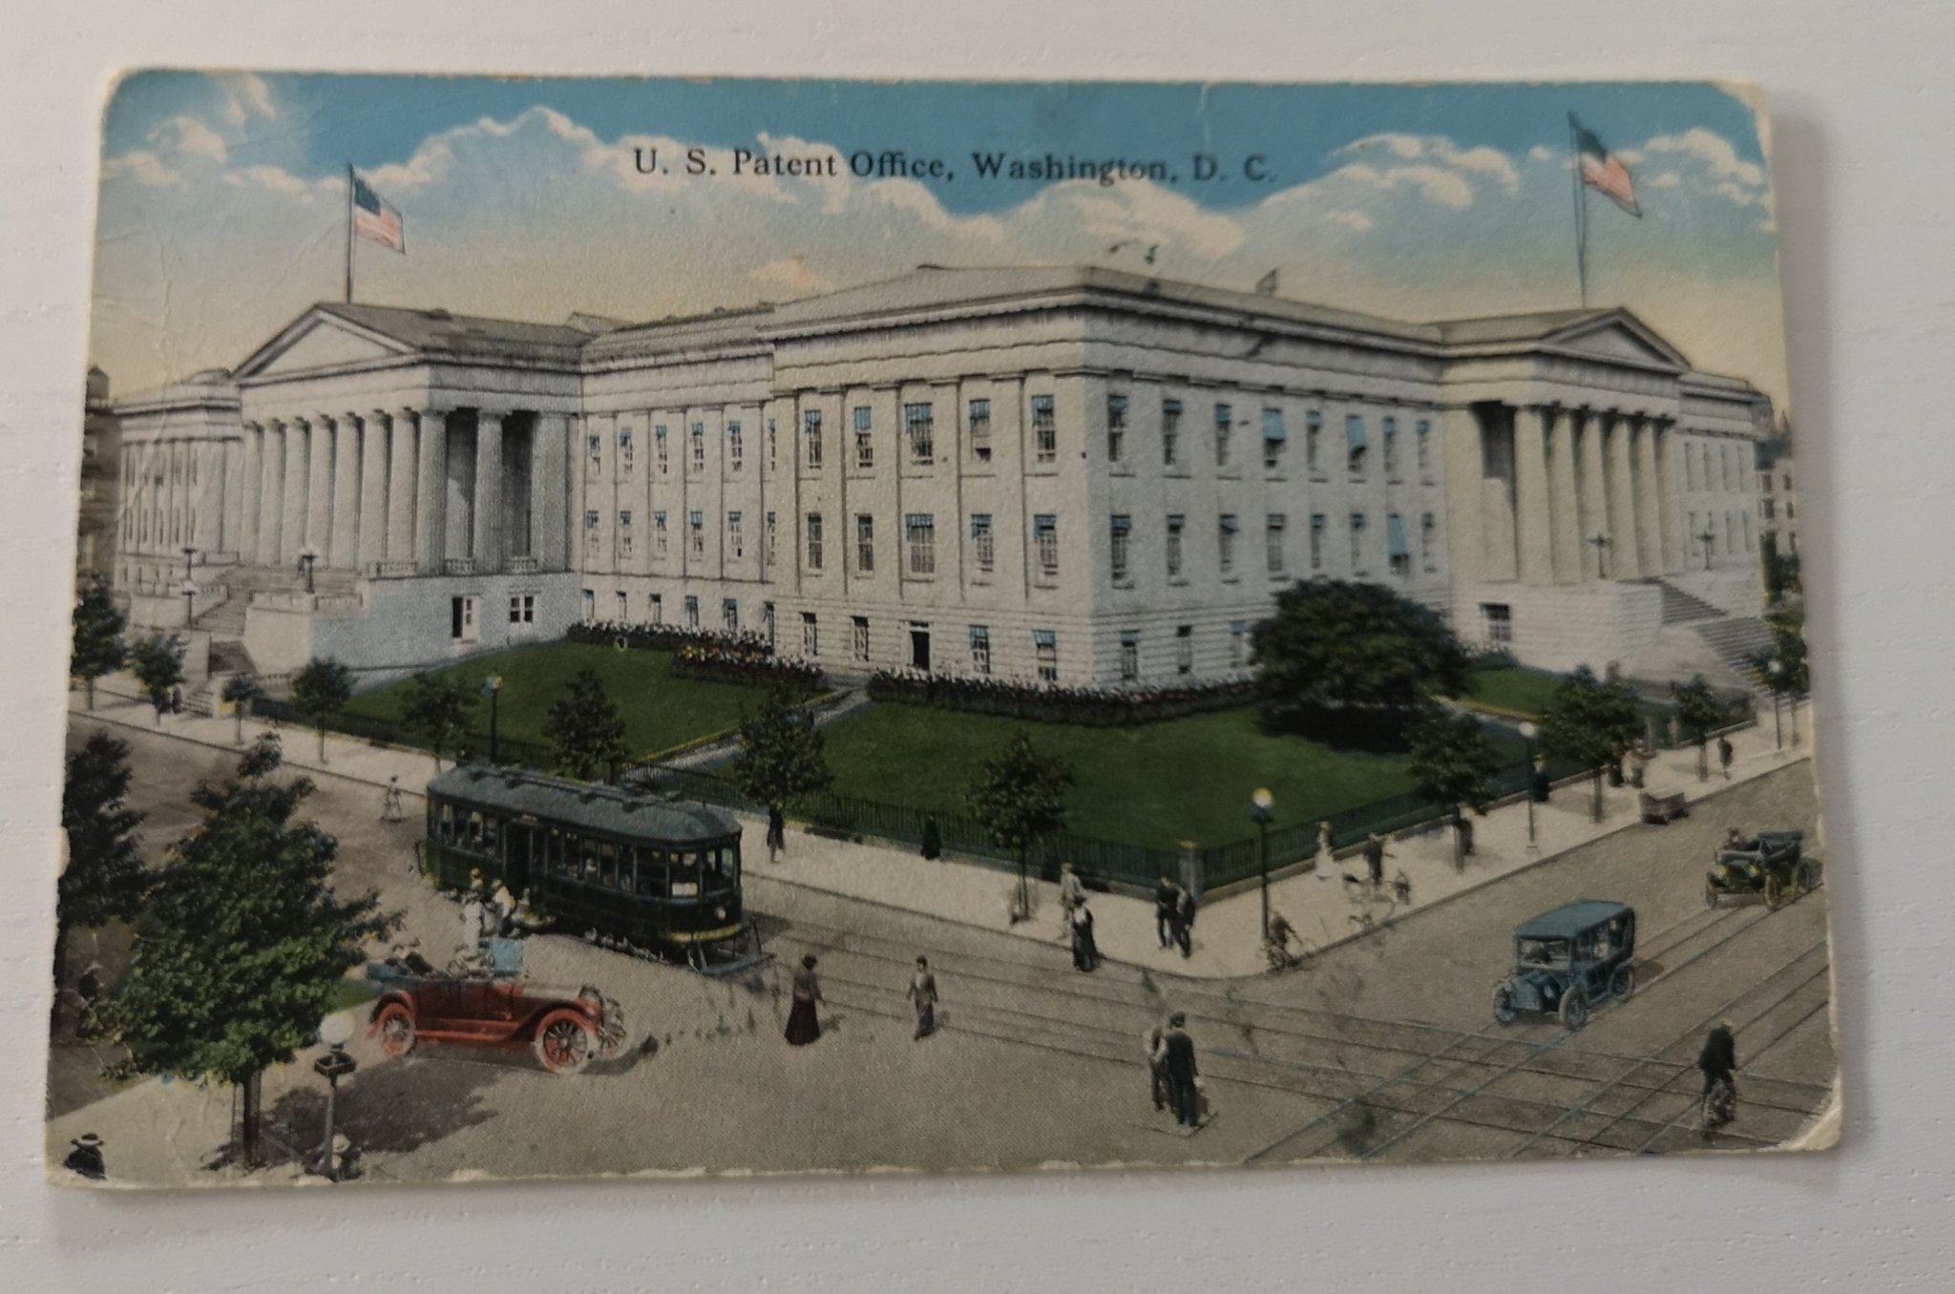

Slide 12
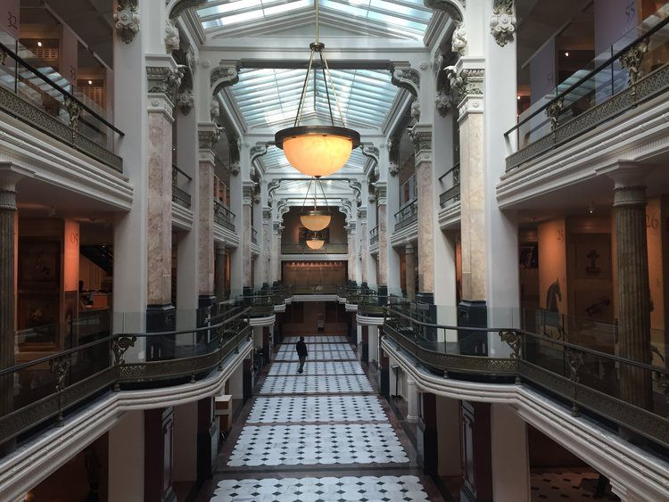
Hall of
Models or the
Old
Model
Museum until 1960s

Slide 13
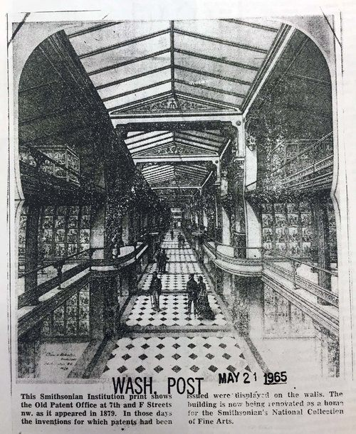

Slide 14
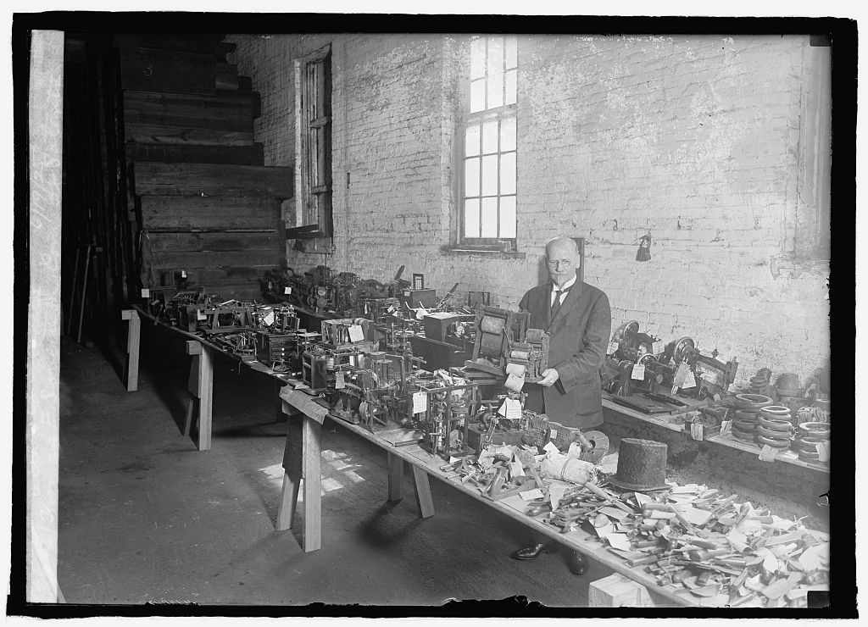
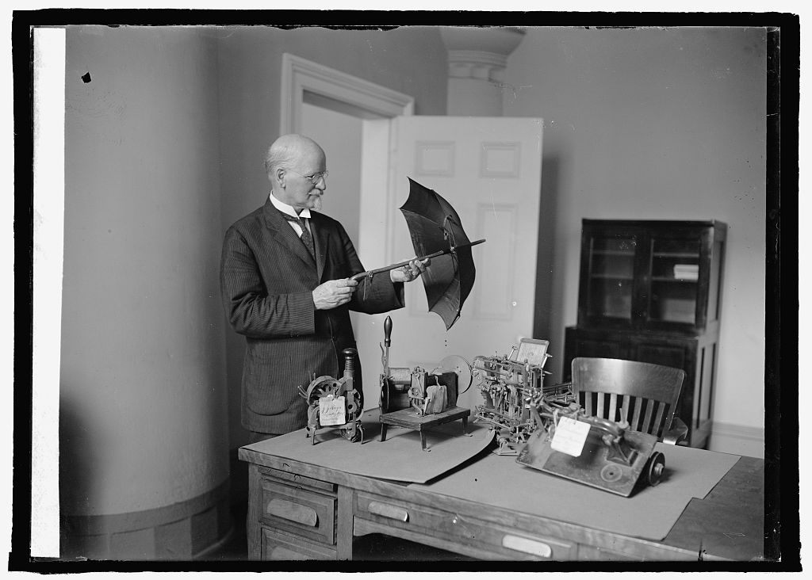

Slide 15
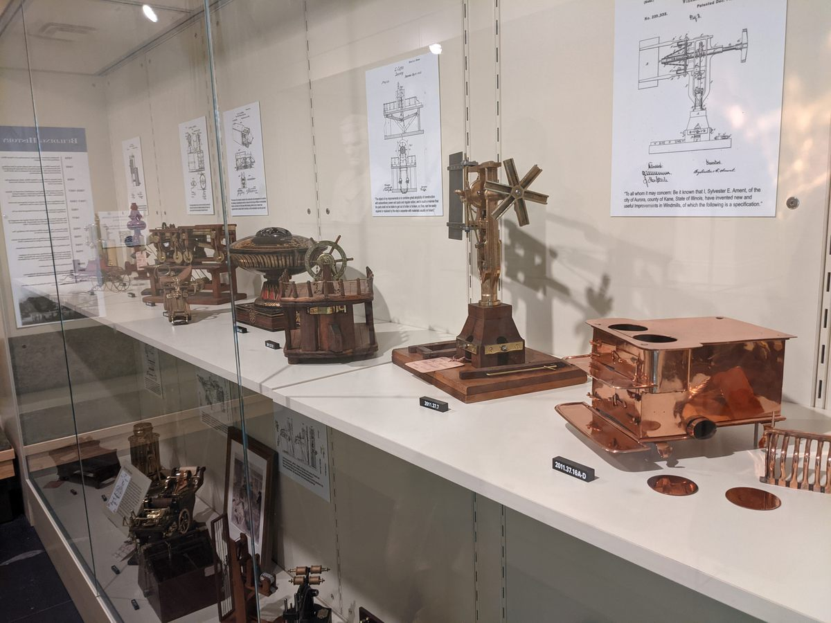

Slide 16
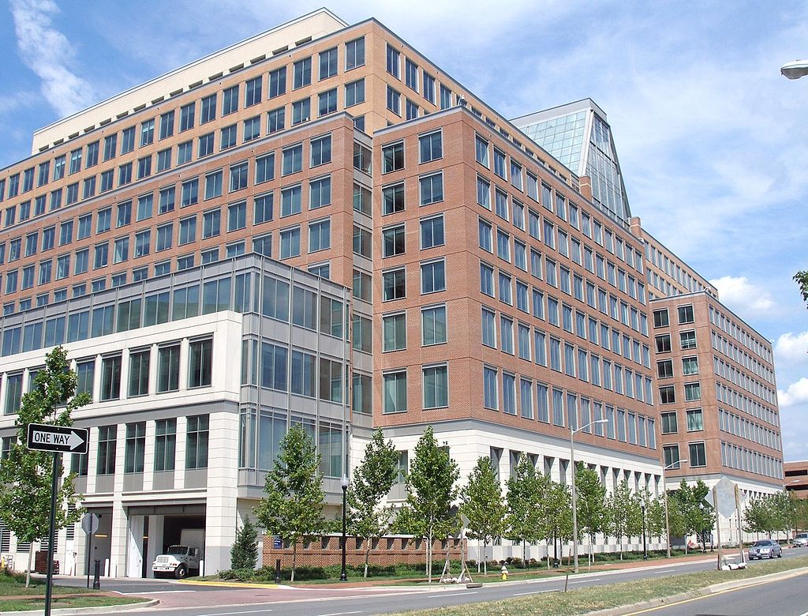
Current Patent Office
five buildings in Alexandria, VA

Slide 17
Current Application Process
Two Types of Patents
Utility Patent (starts at 699) protects how the invention works
Design Patent (starts at $999) protects how the invention looks
Get help:
https://www.allinoneinventions.com/patent-an-idea

Slide 18
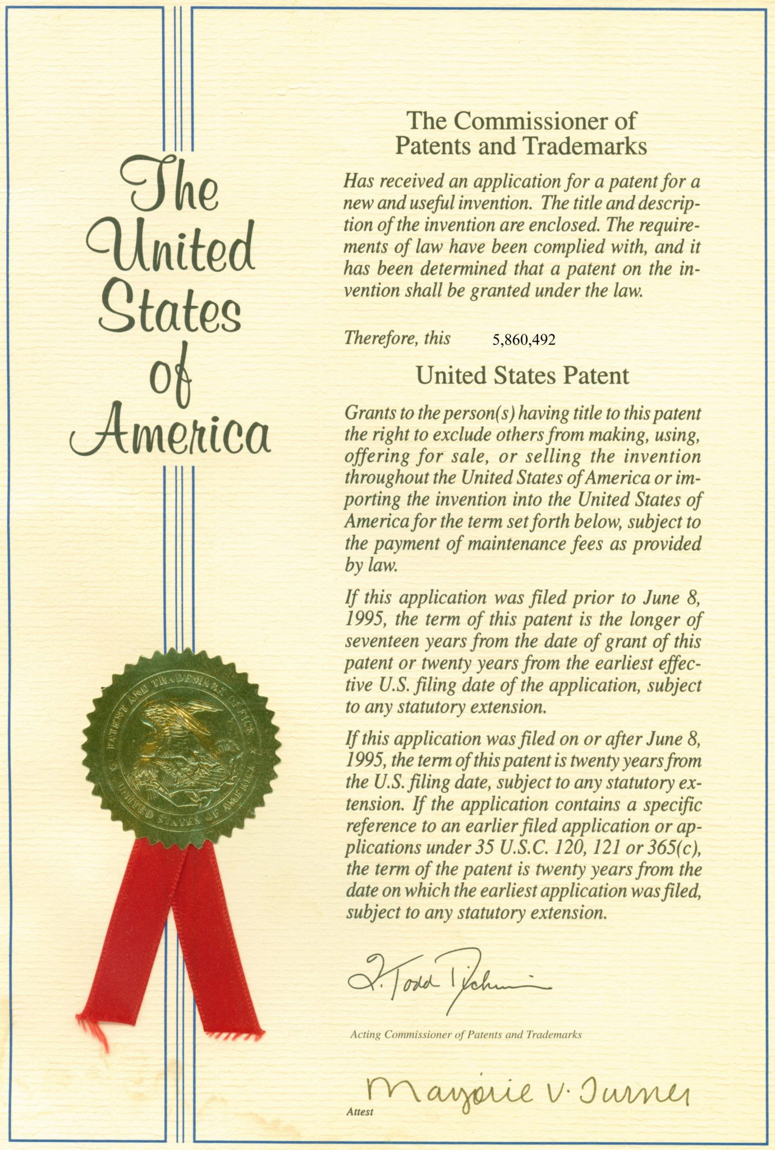
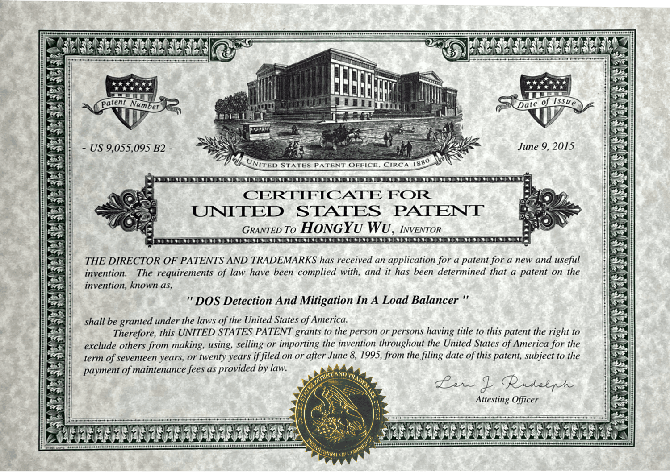

Slide 20
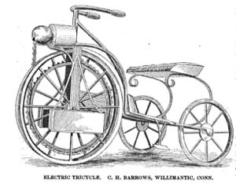
C. H. Barrows b. 1841

Slide 21
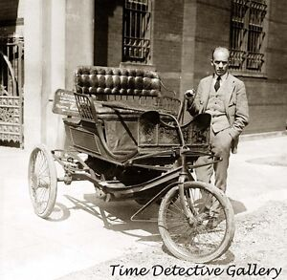

Slide 22

Charles Barrow’s Electric Tricycle

Slide 23
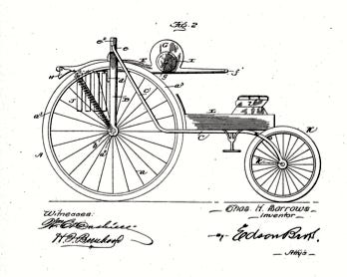

Slide 24
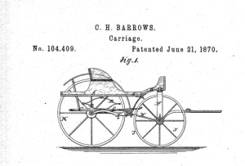

Slide 25
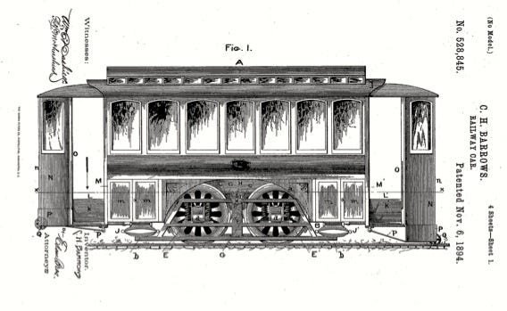

Slide 26
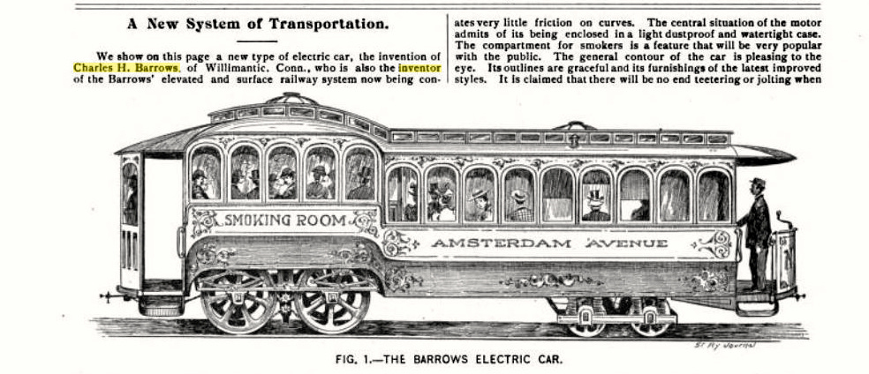

Slide 27
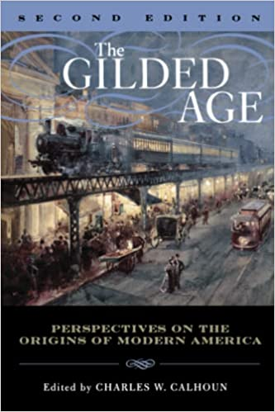
r
r

Slide 28
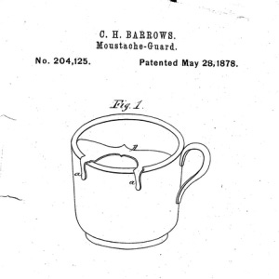

Slide 29
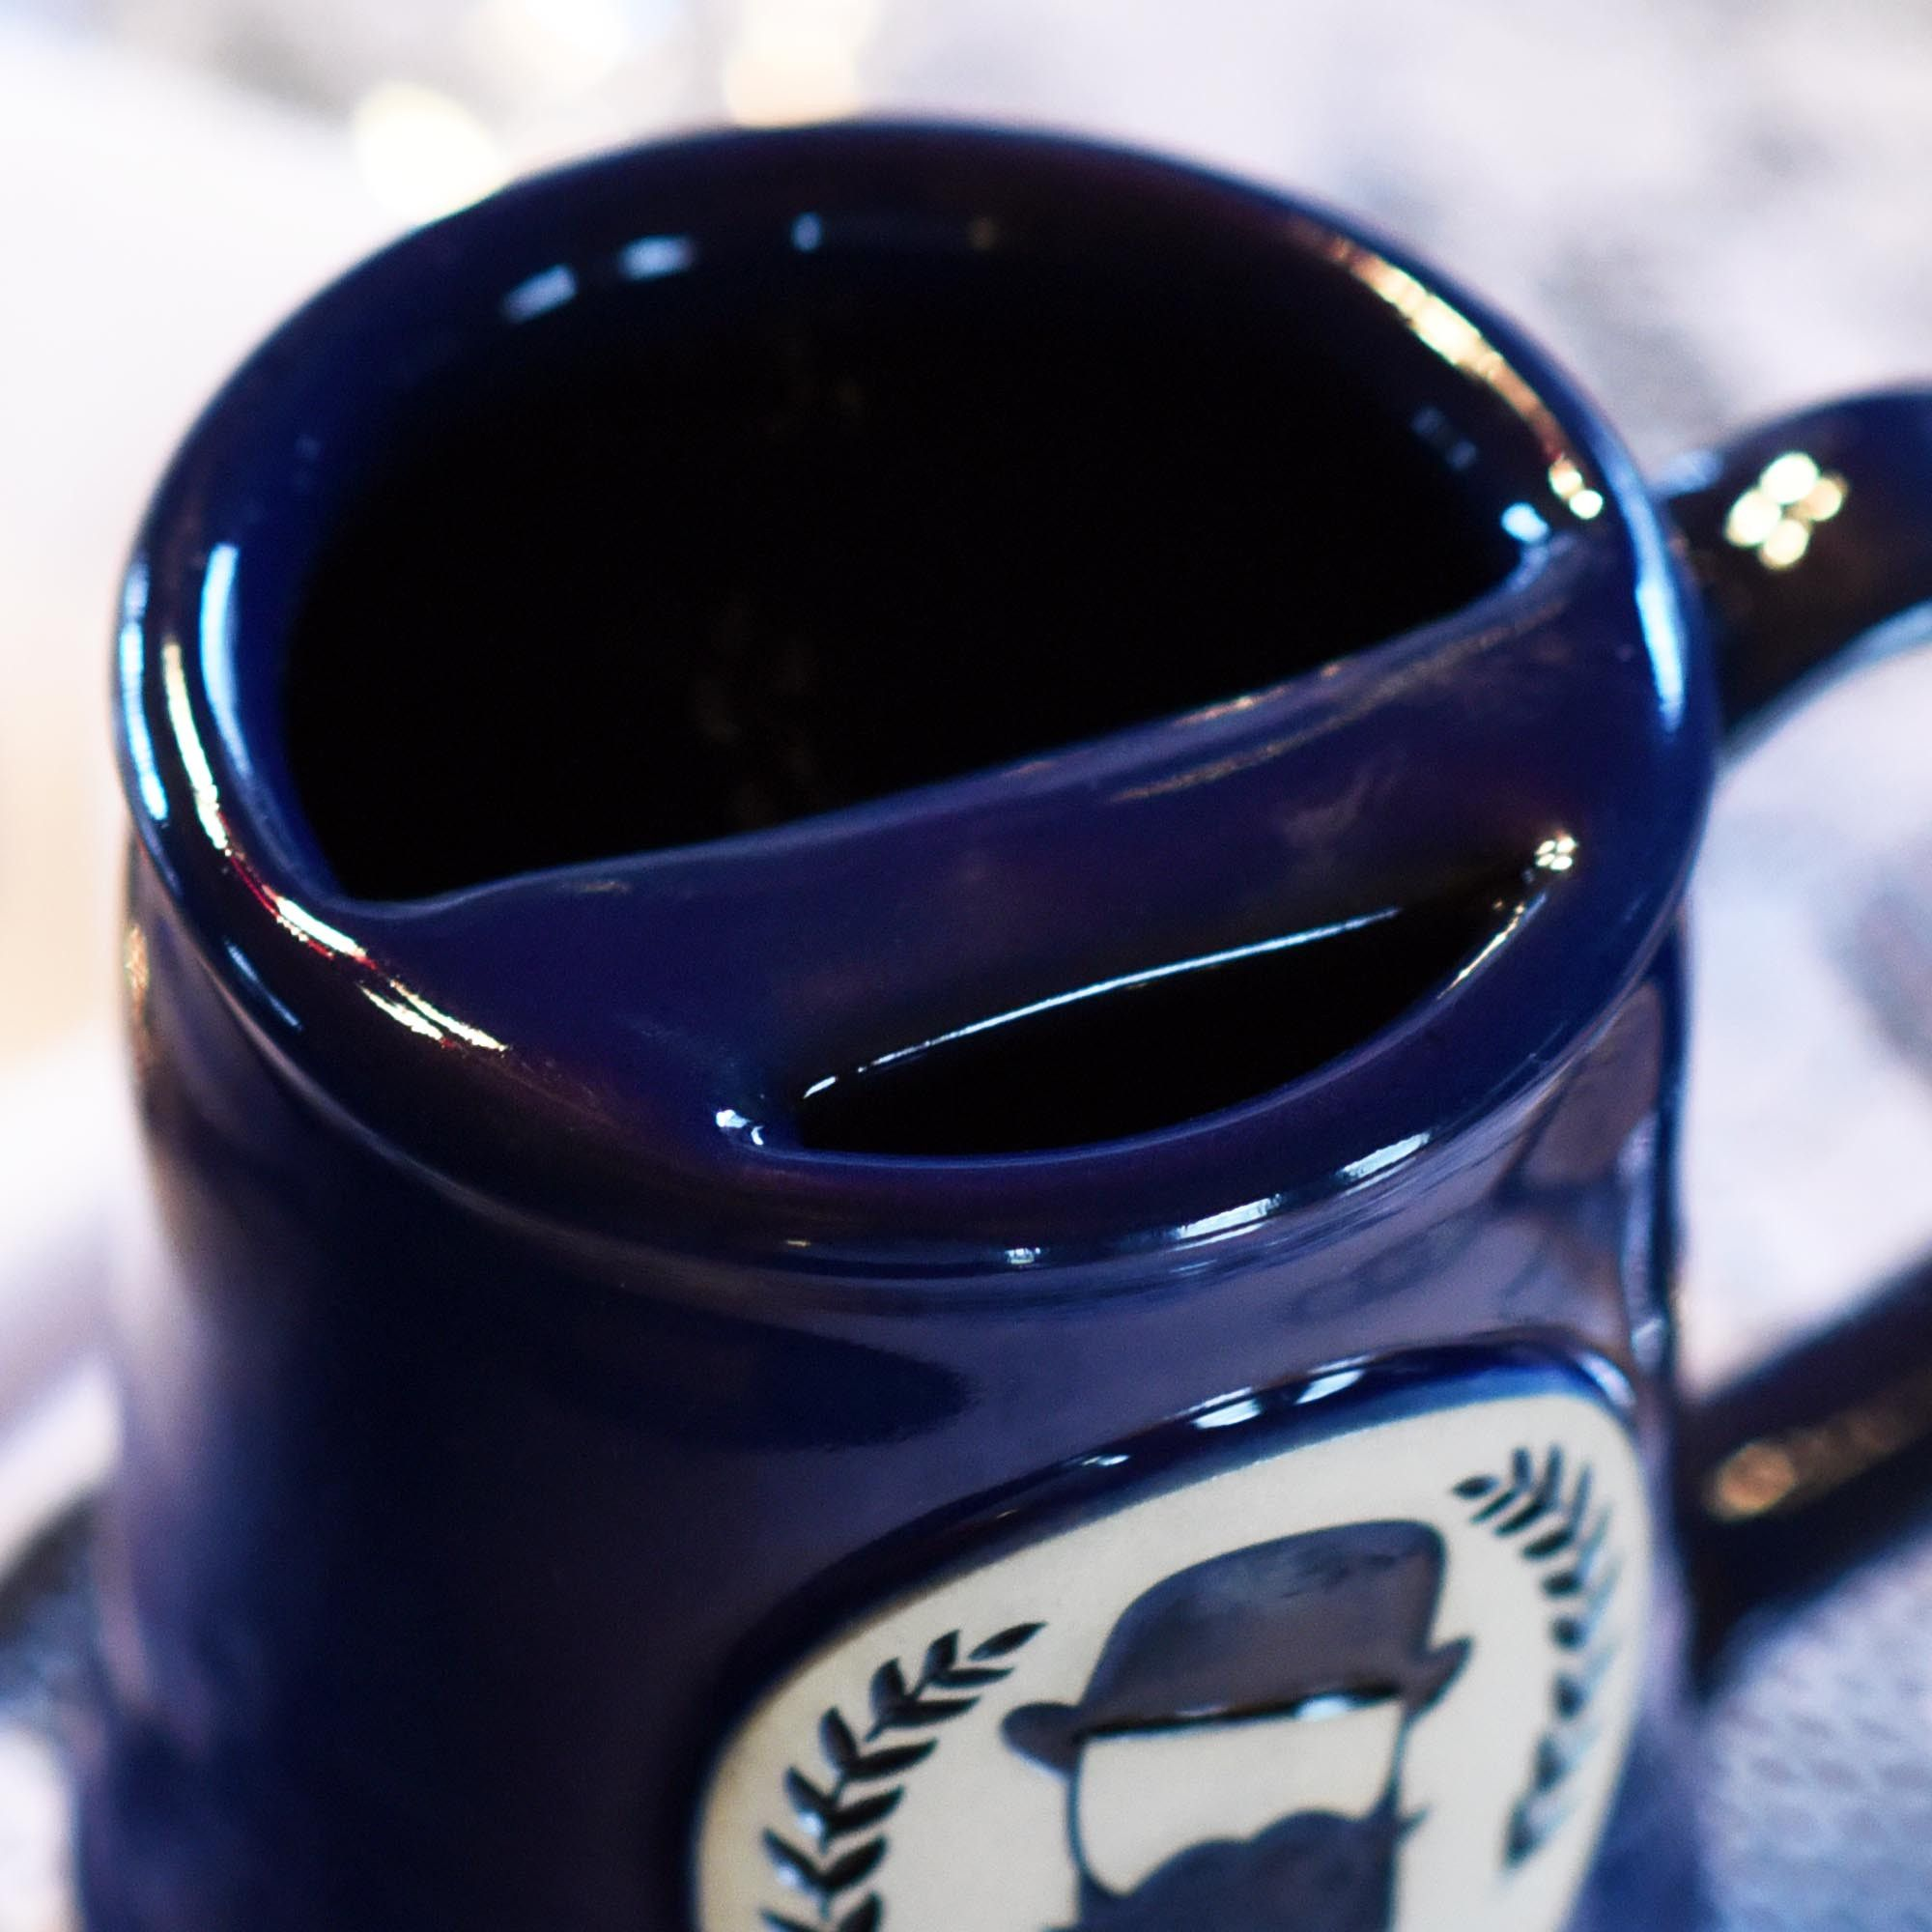
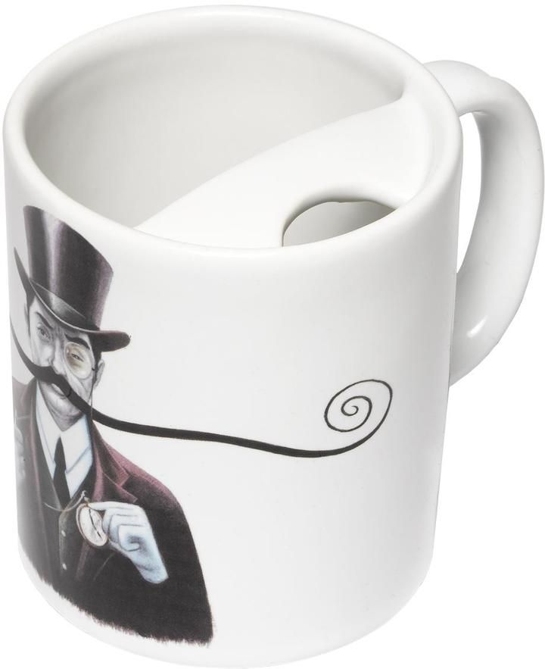
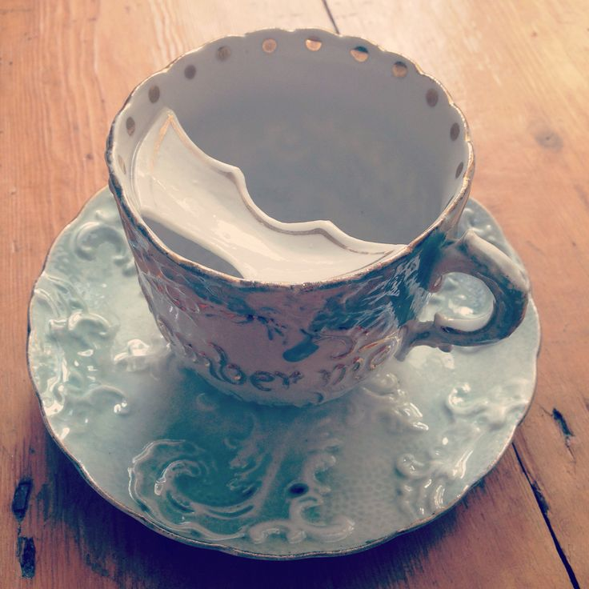
Download original file1582 × 2068 px png
View in browser
You can attribute the author
Show me how

Slide 30
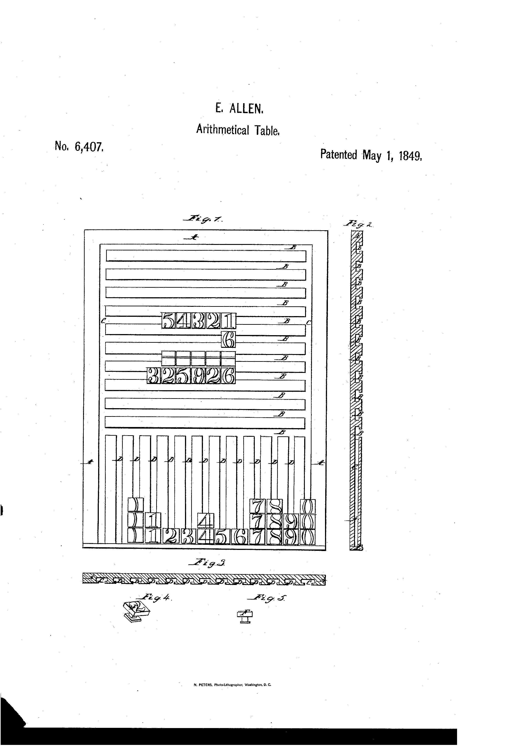
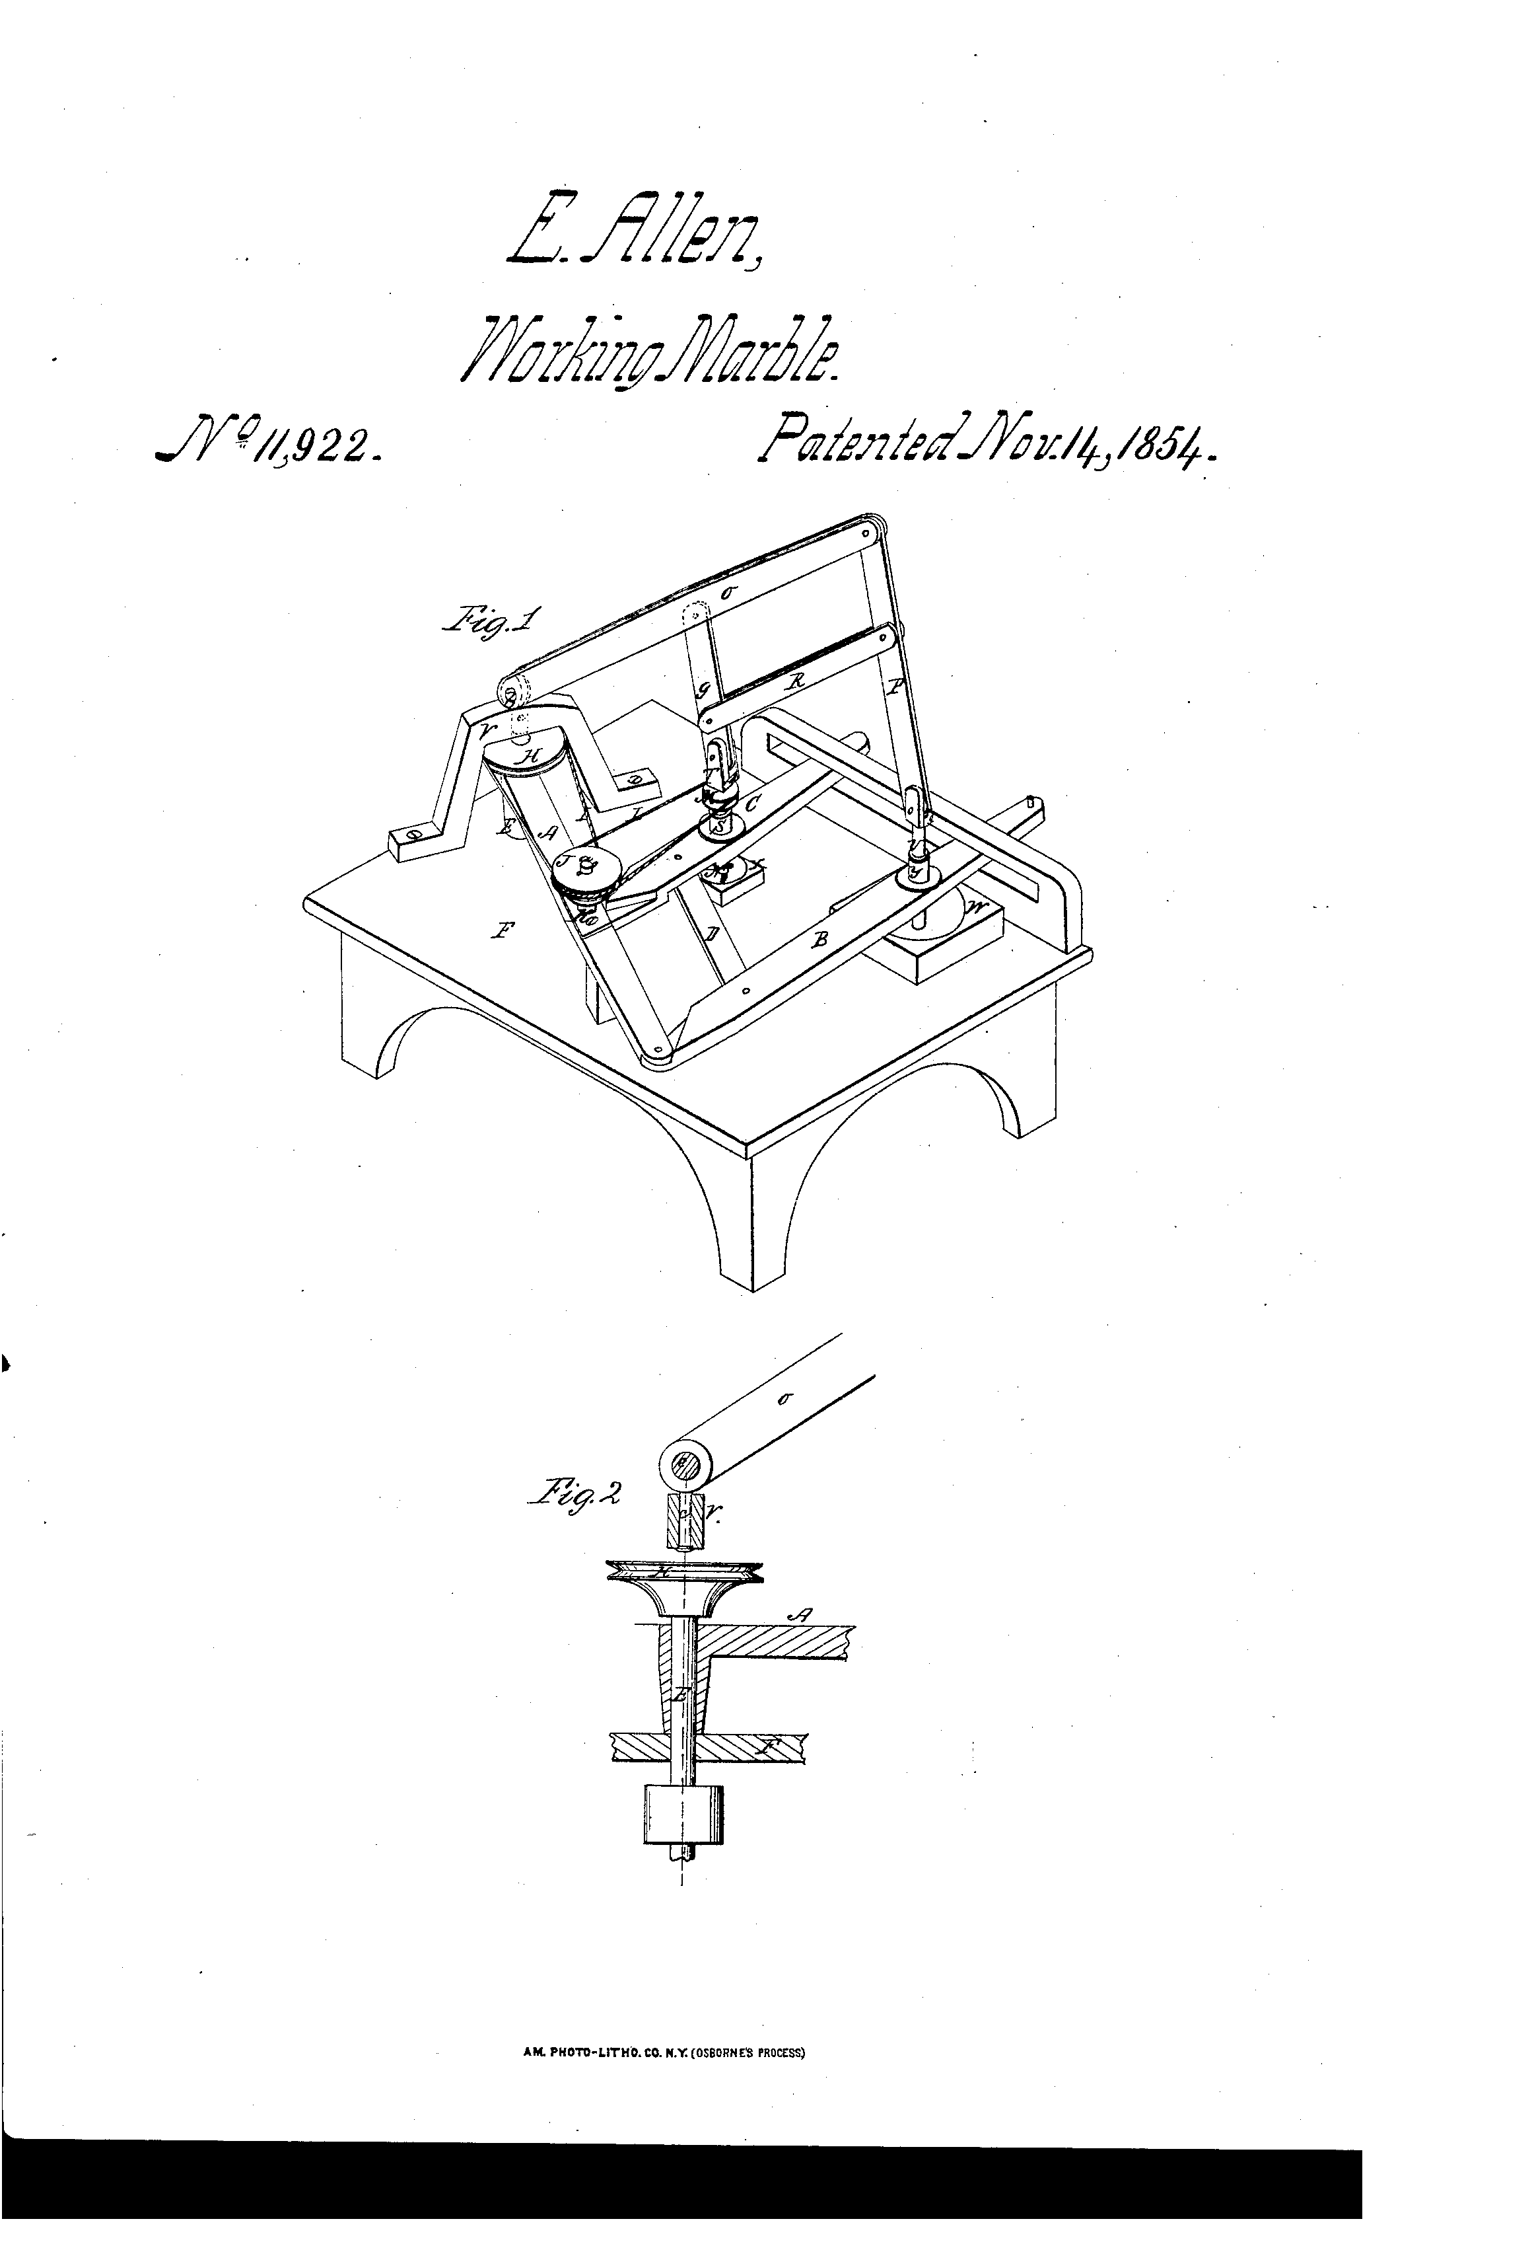

Slide 31
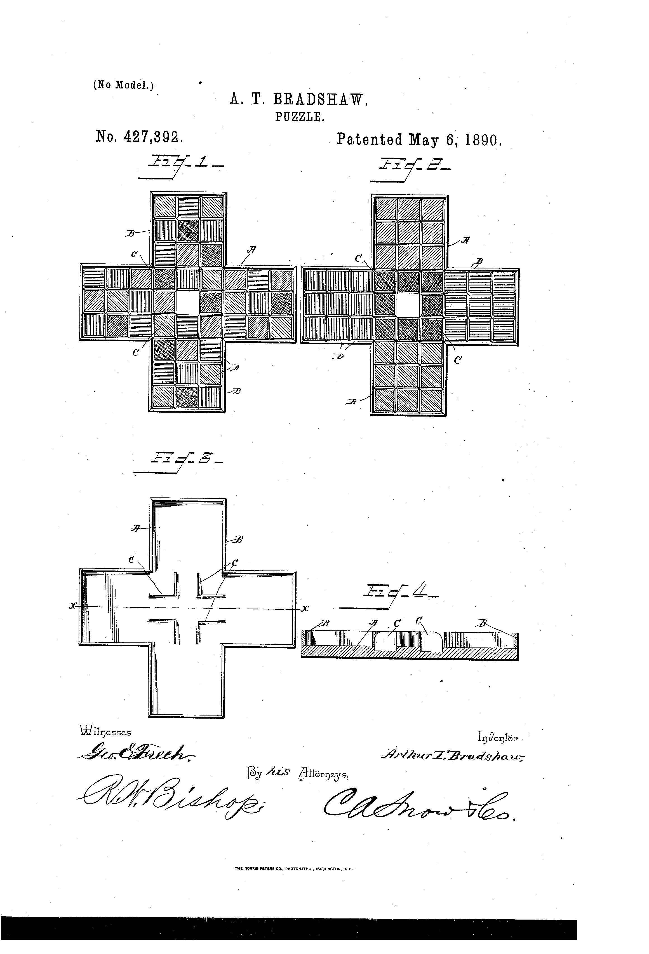
Move block pieces one at a time until solved

Slide 32
Sliding Puzzles

Slide 33
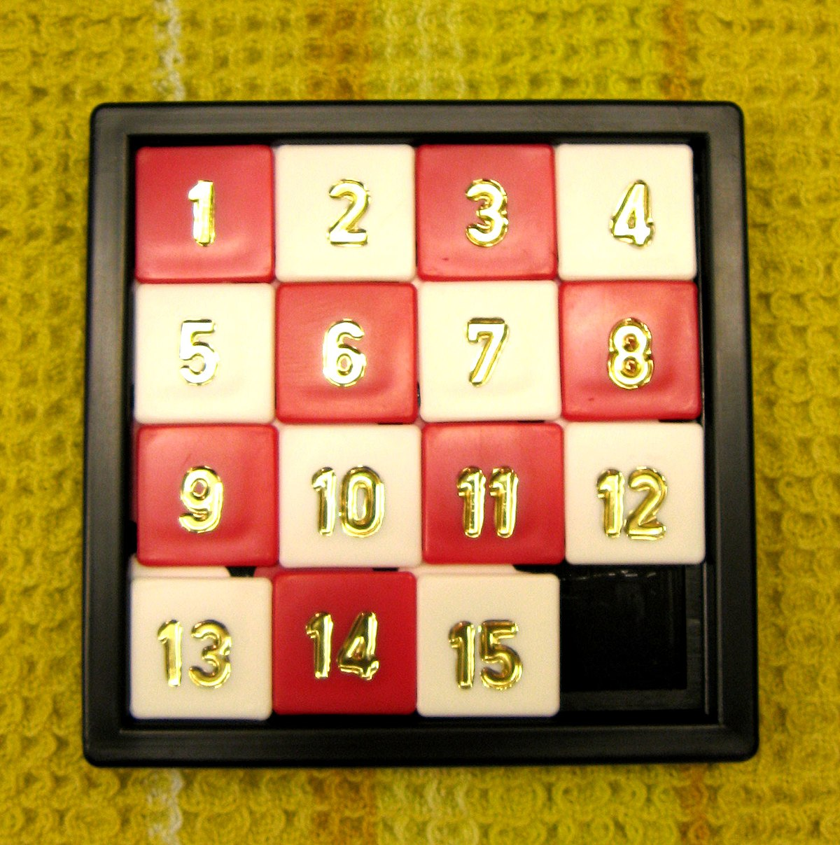
#15
15 Puzzle
Gem Puzzle
Boss Puzzle
Mystic Square
Inspired by Windham Games
Invented by Noyes Palmer Chapman of N.Y.

Slide 34
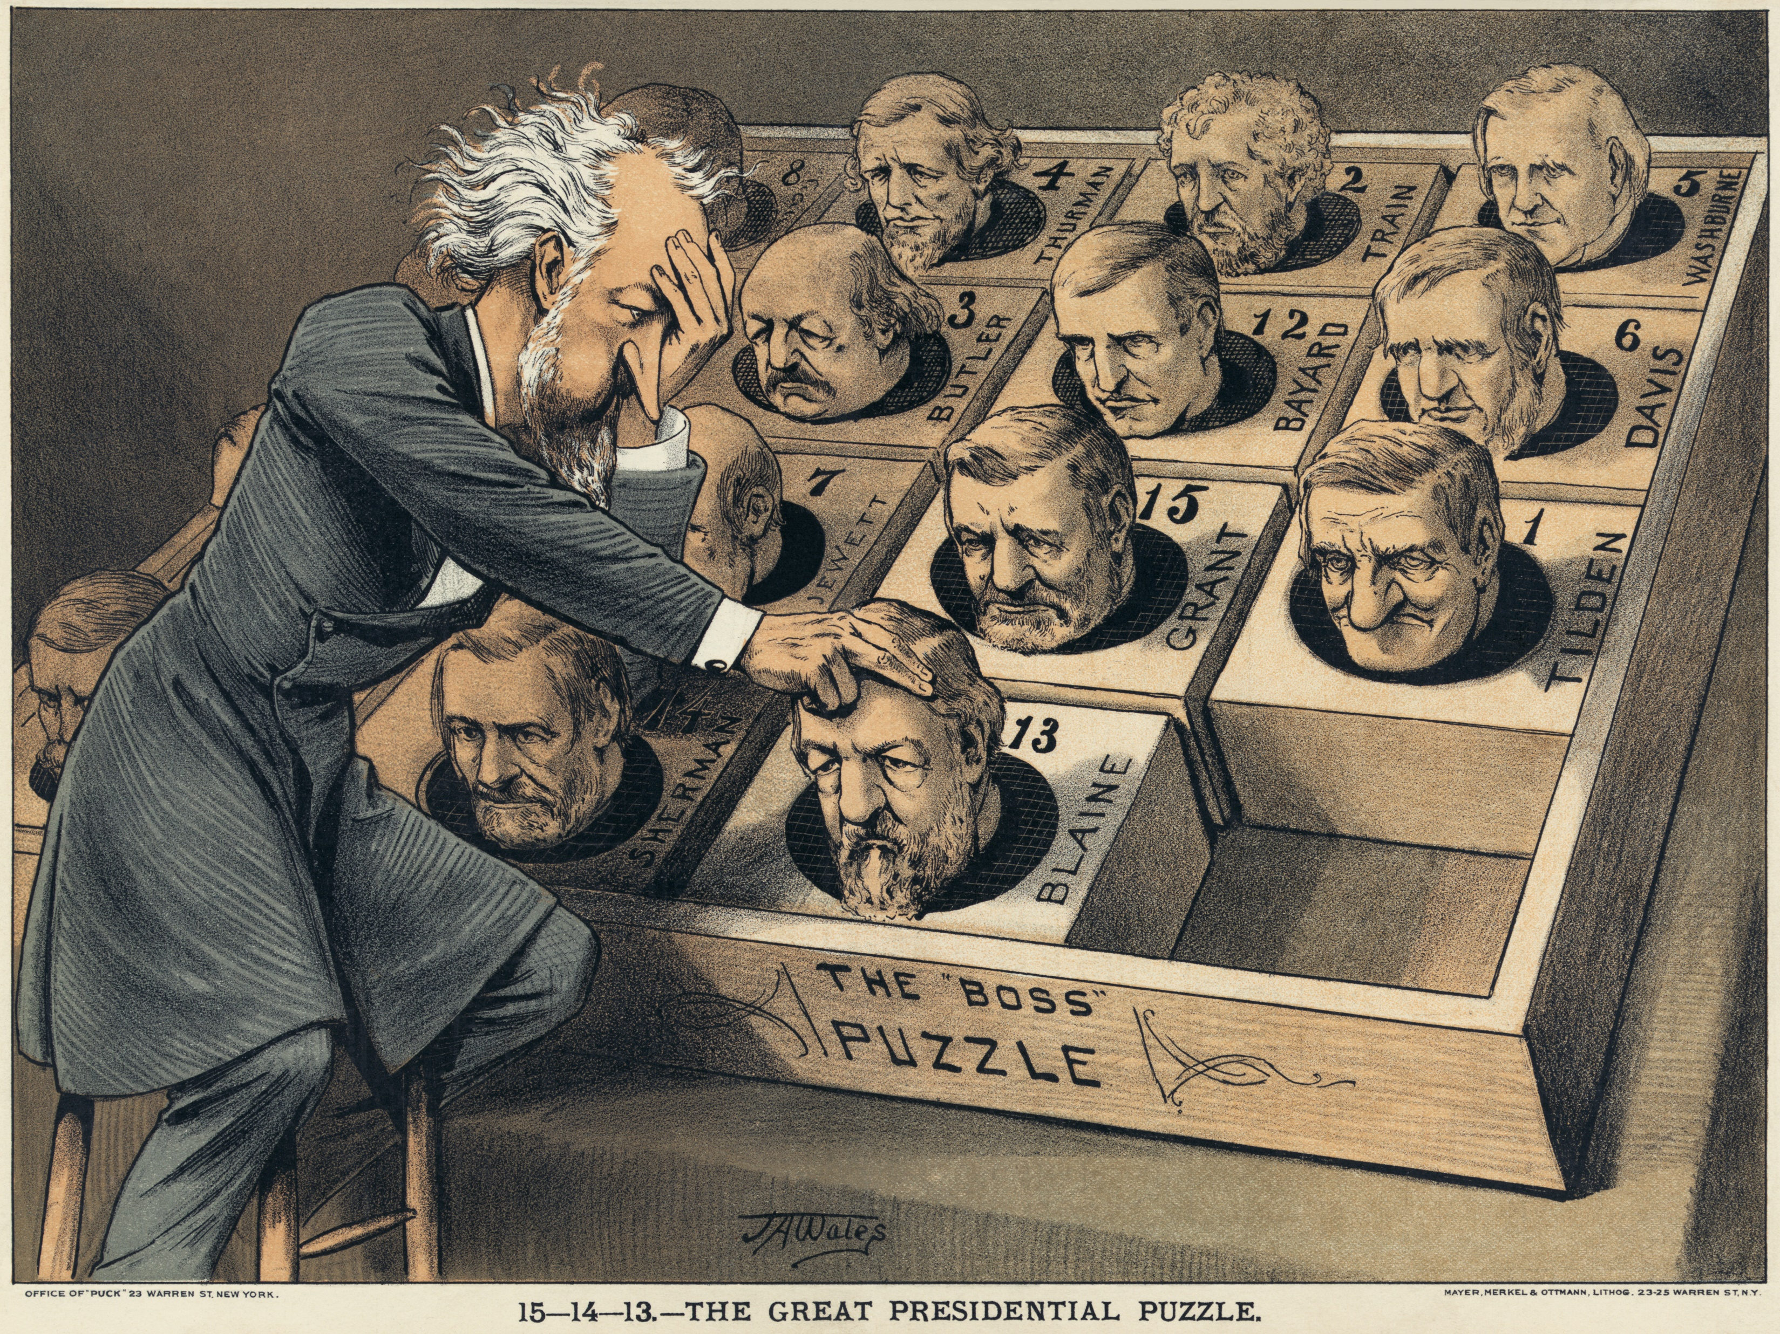
1880 election

Slide 35
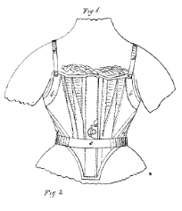
Catherine
Griswold
CORSET
IMPROVEMENTS

Slide 36
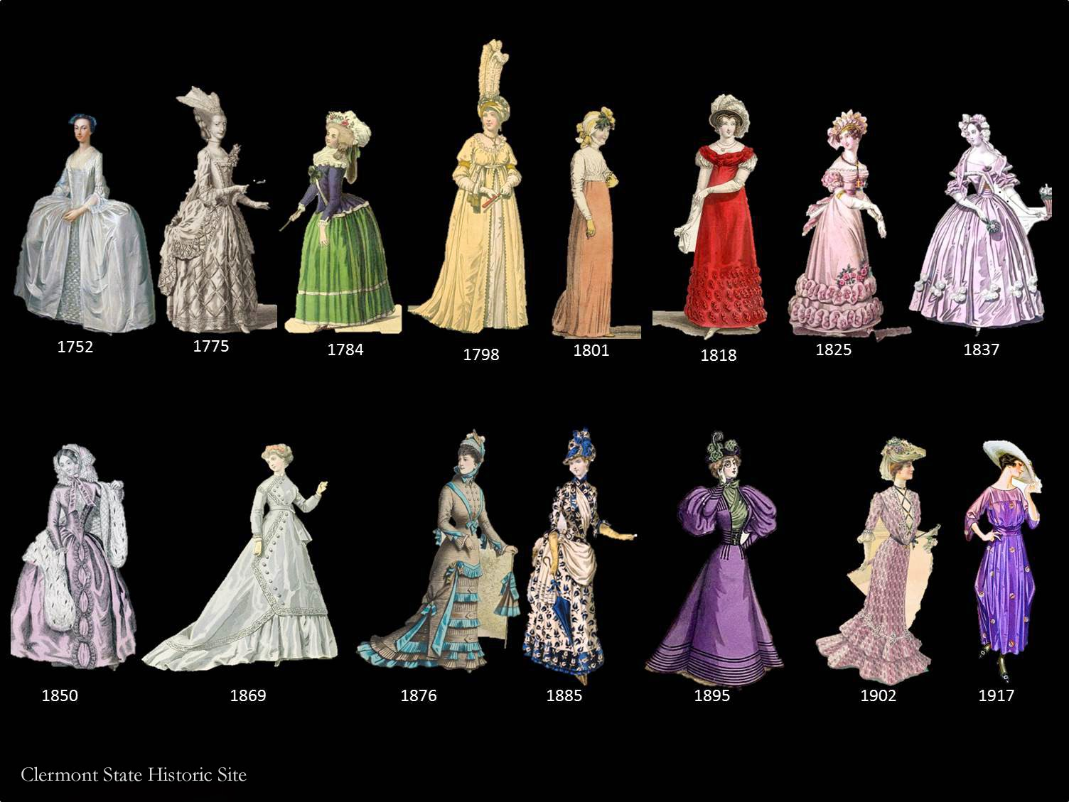

Slide 37
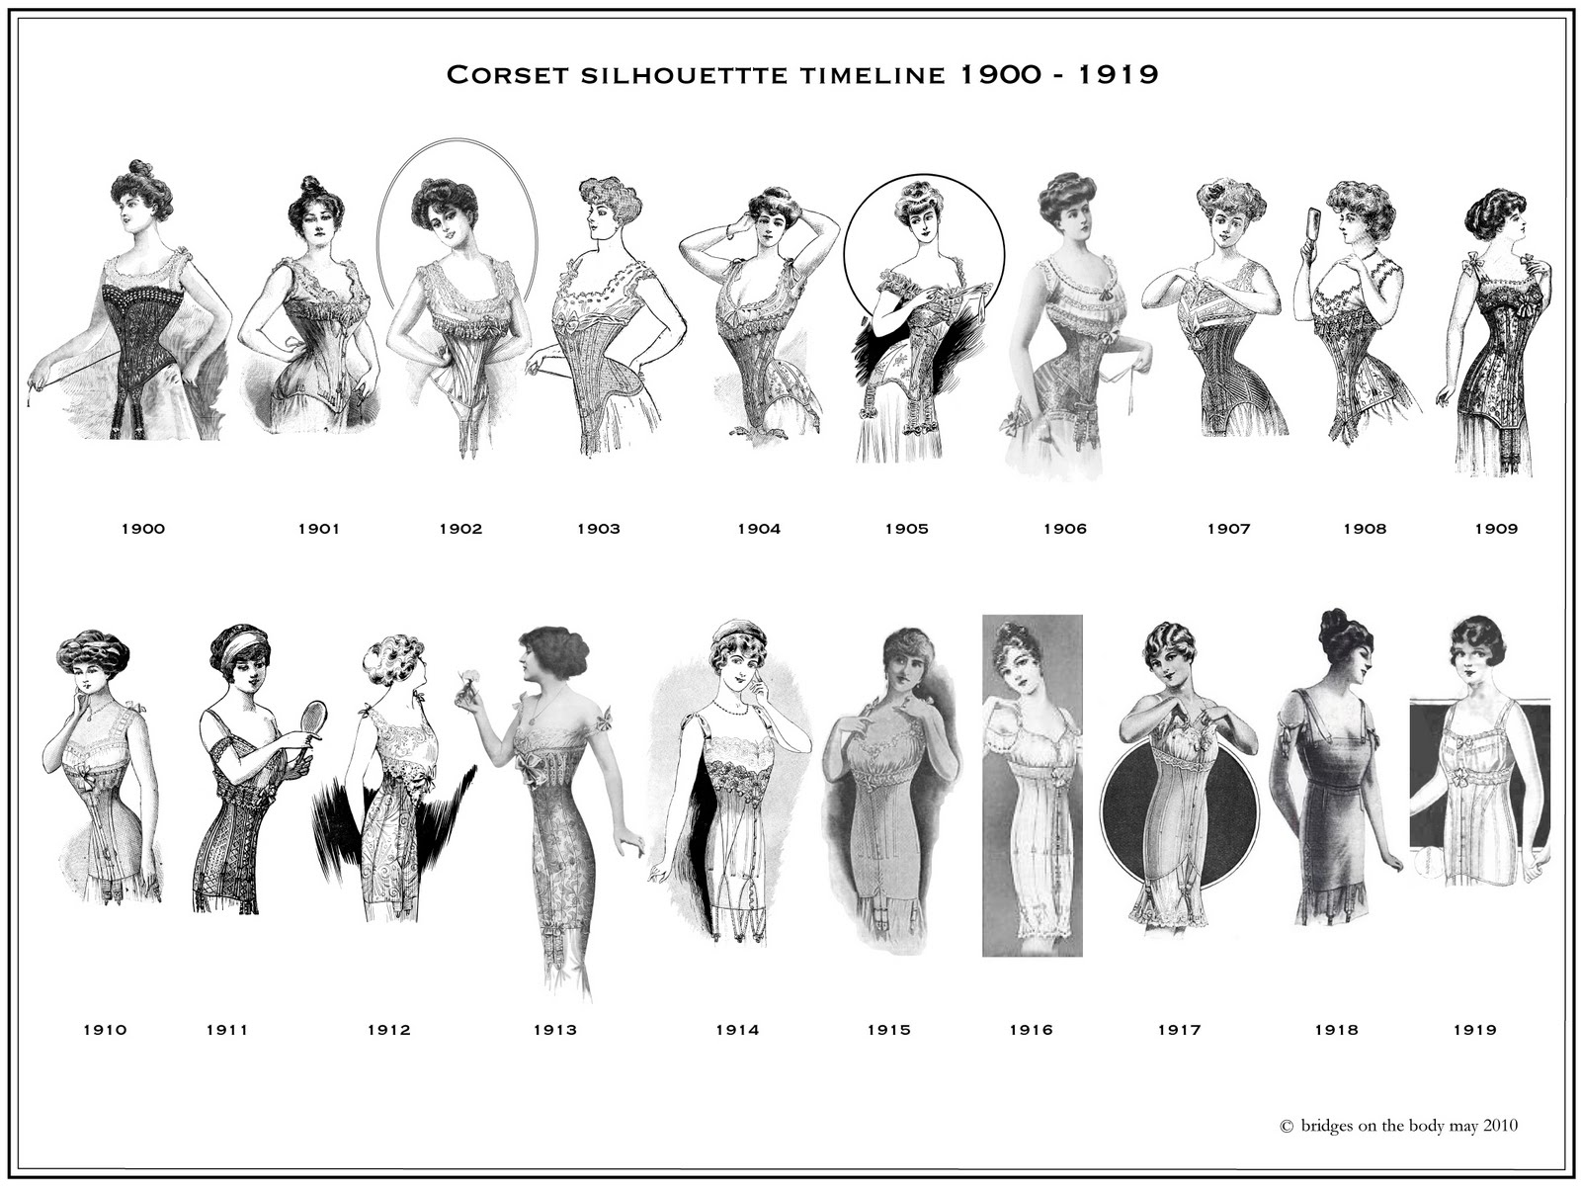

Slide 38
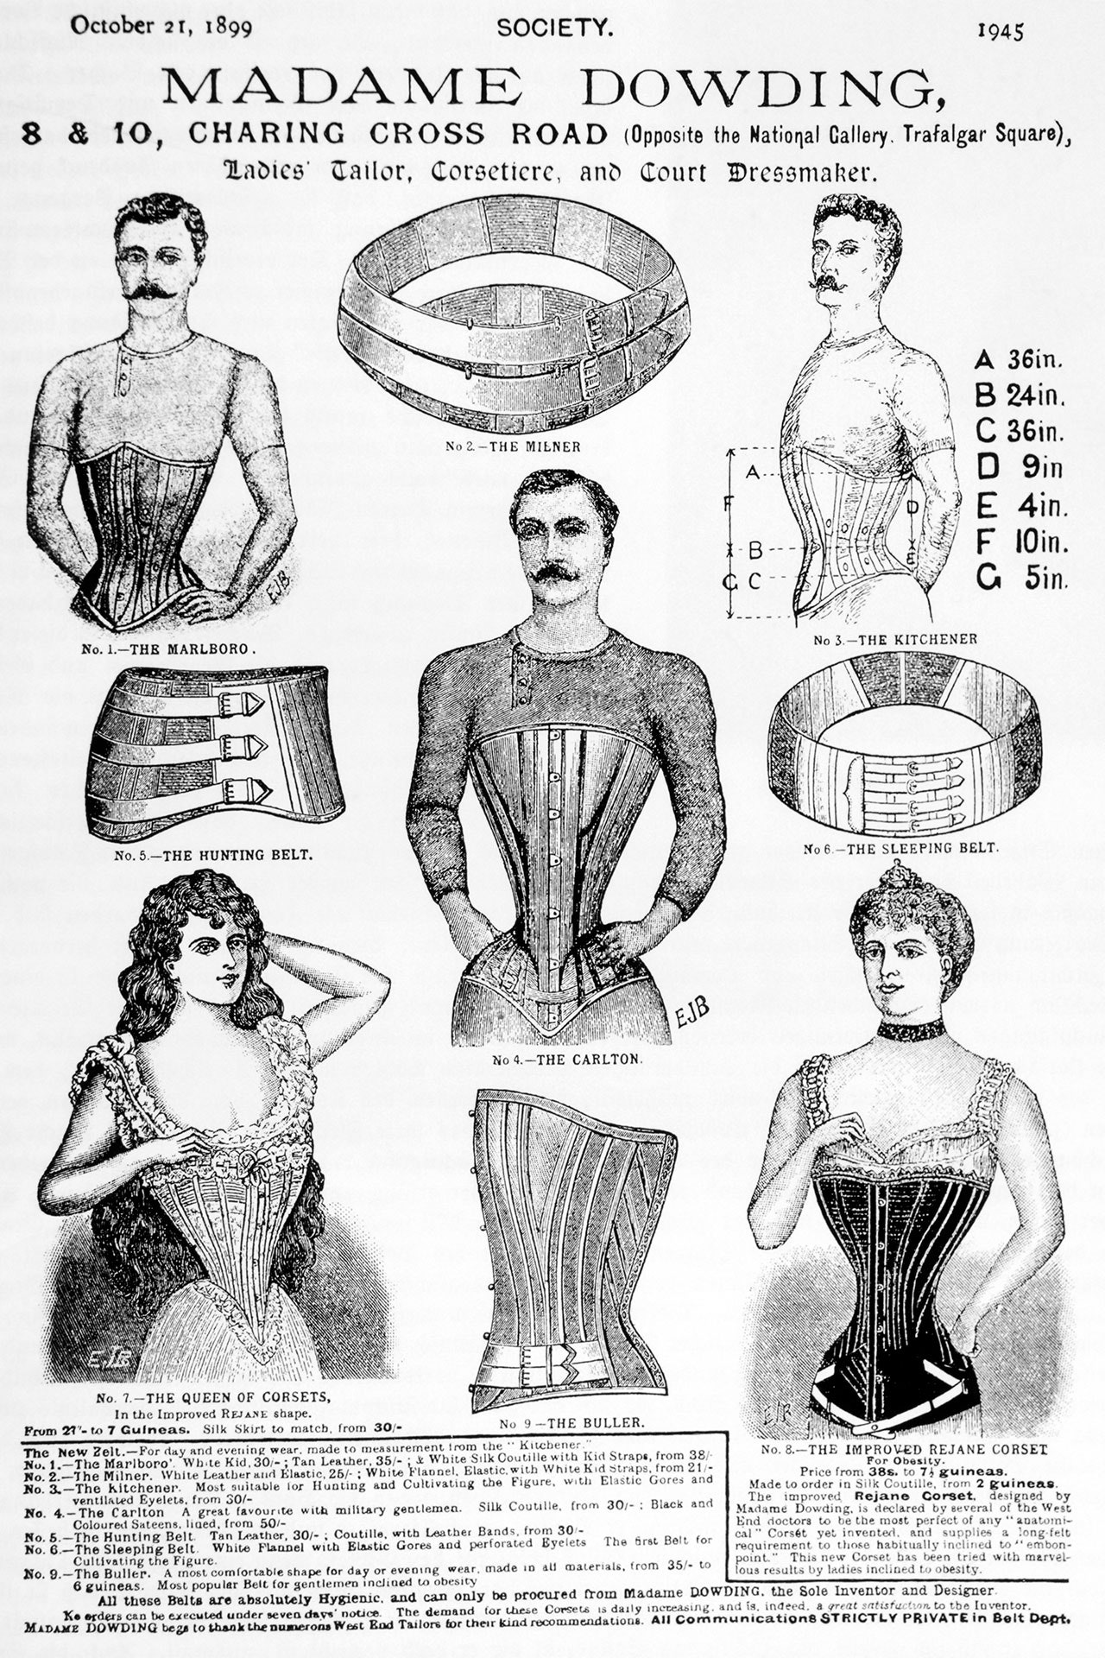
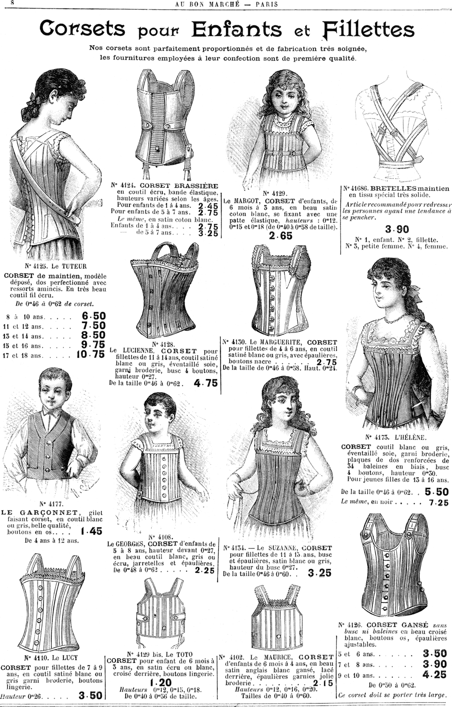

Slide 39
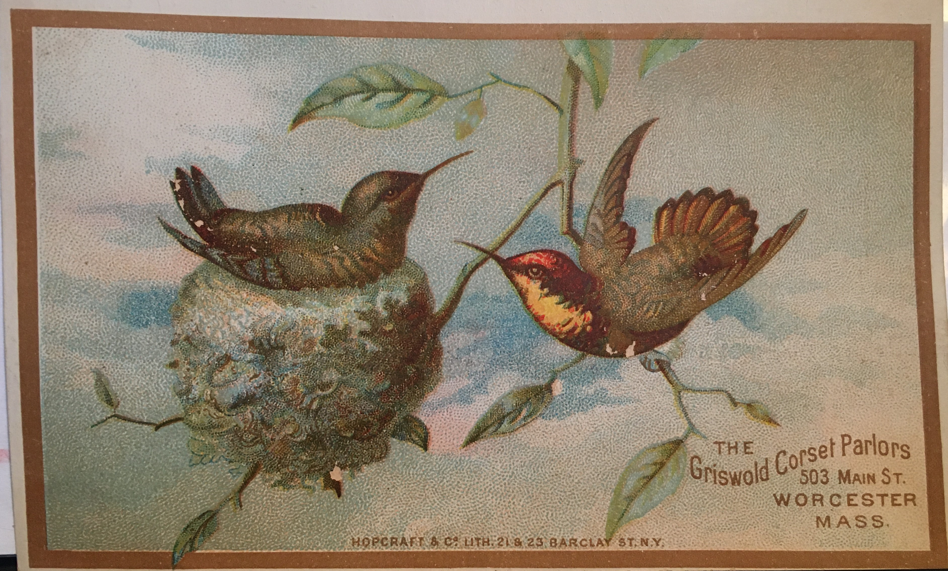

Slide 40
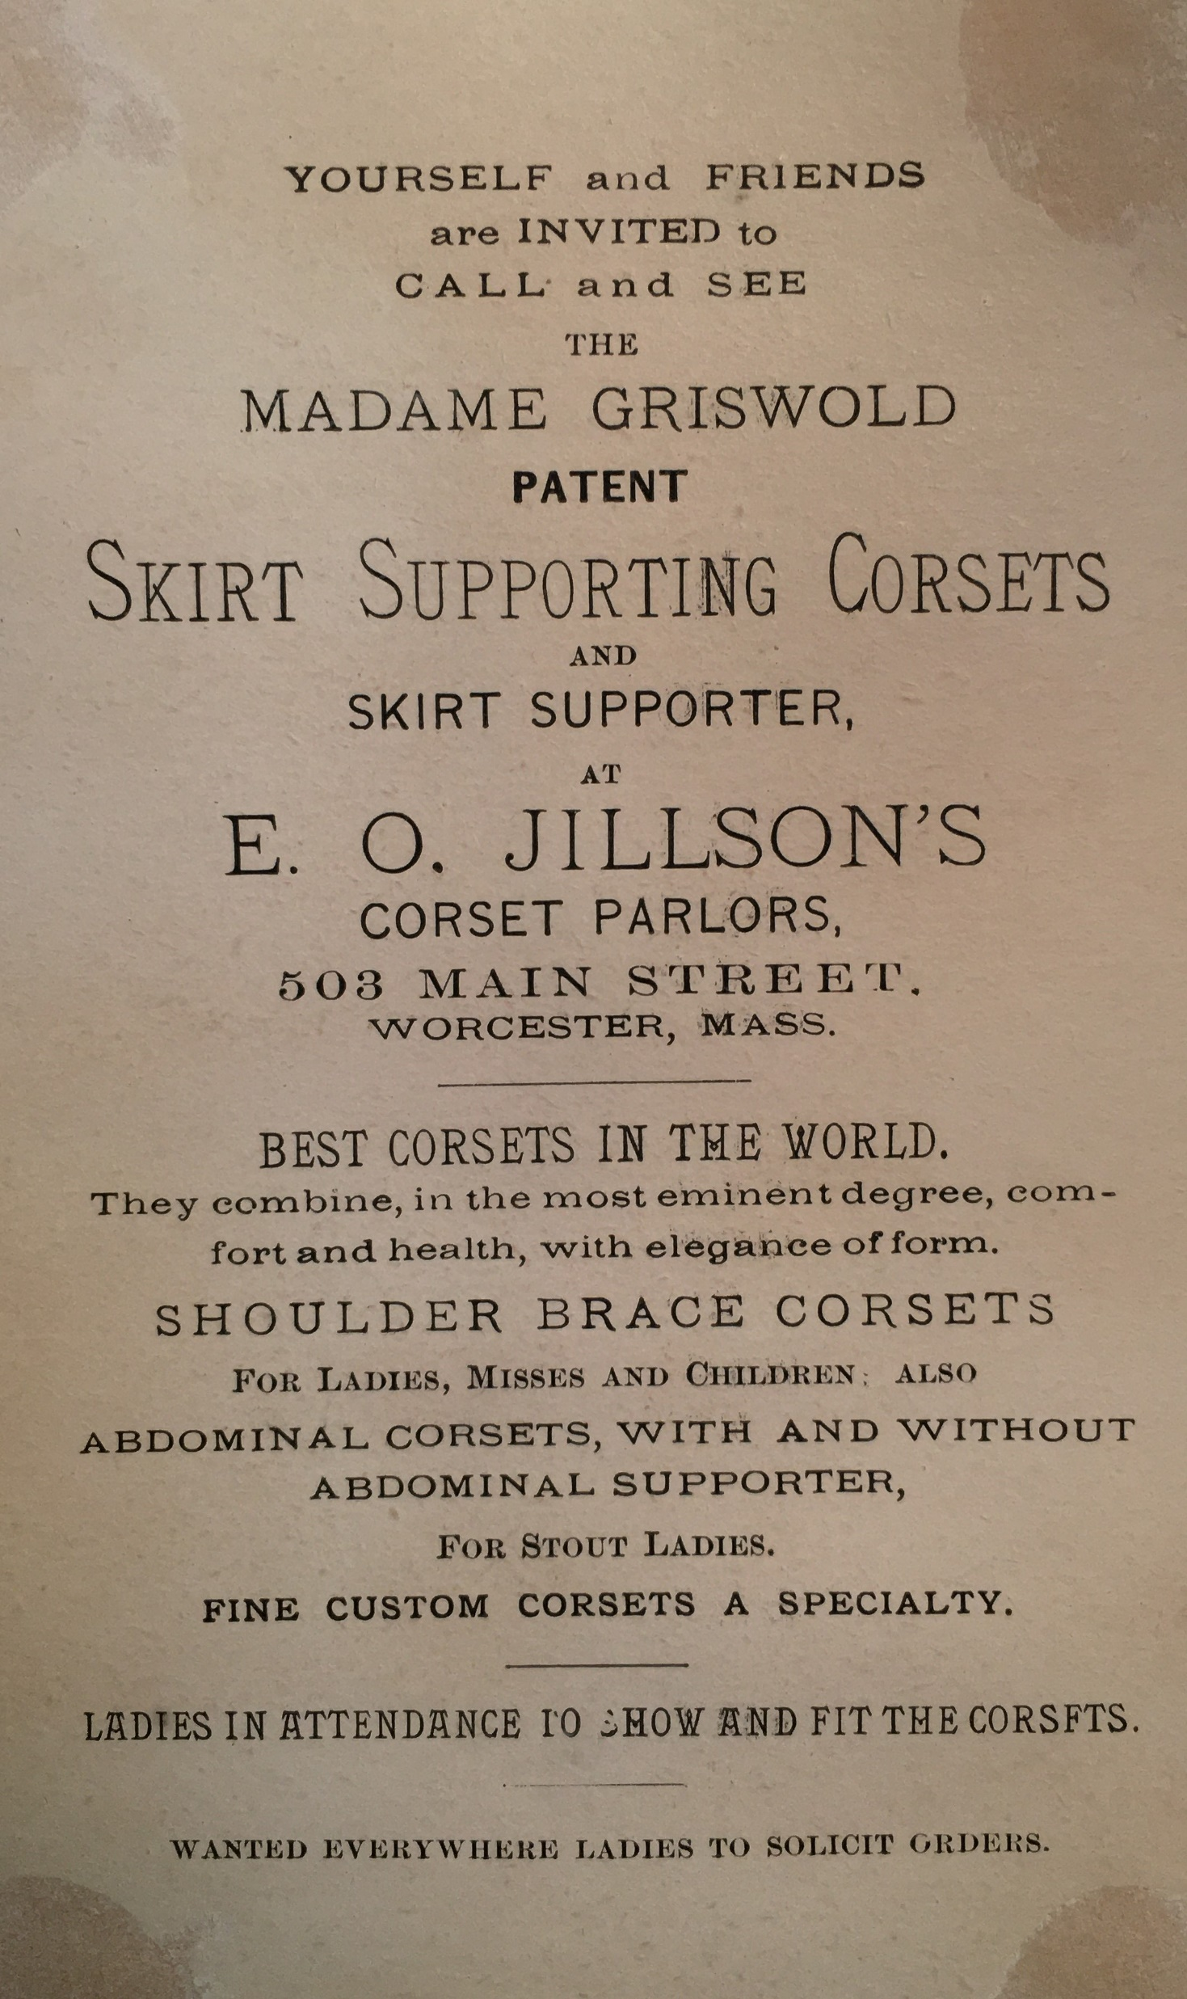

Slide 41
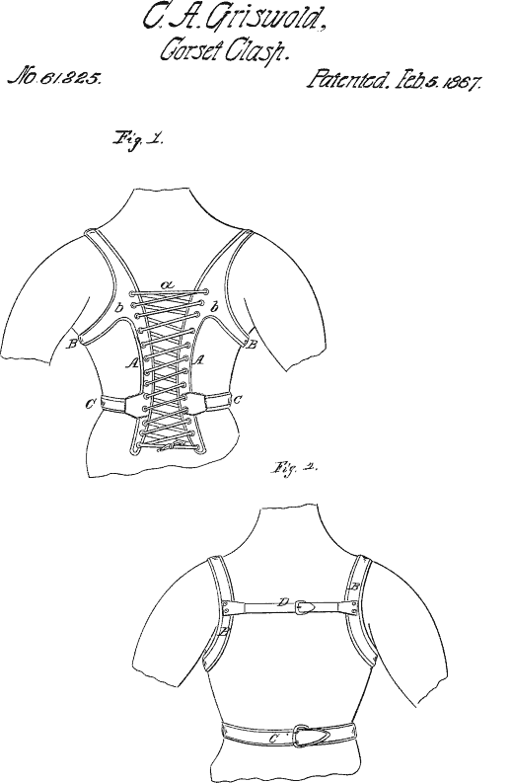

Slide 42
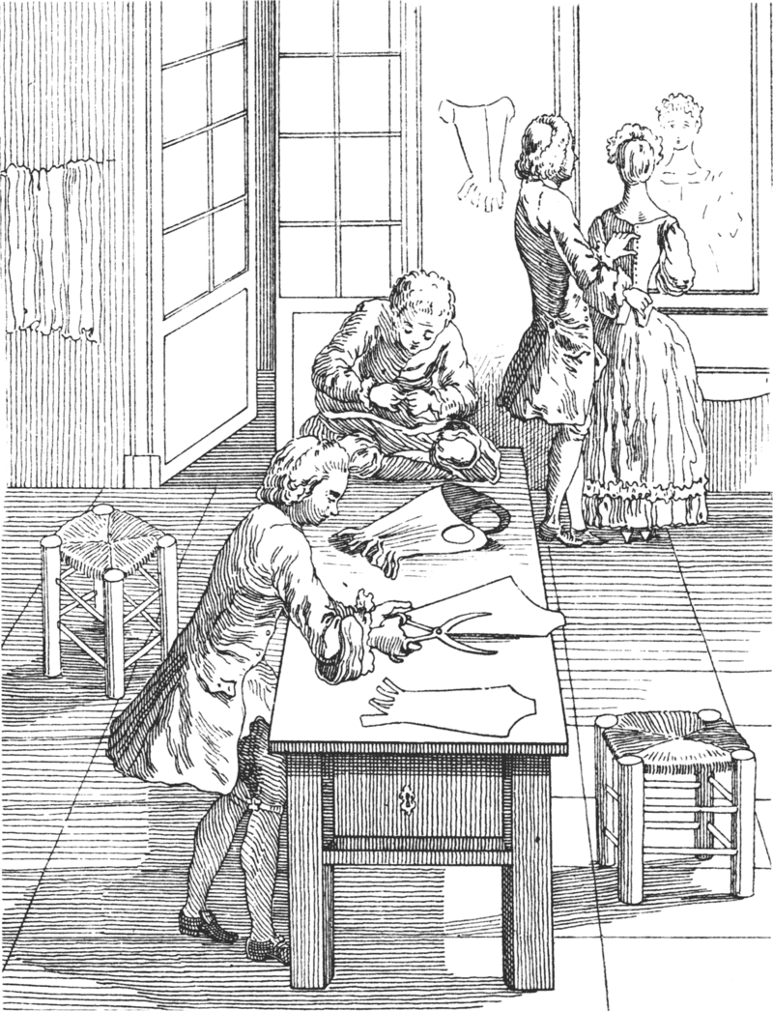
Download original file1582 × 2068 px png
View in browser
You can attribute the author
Show me how

Slide 43
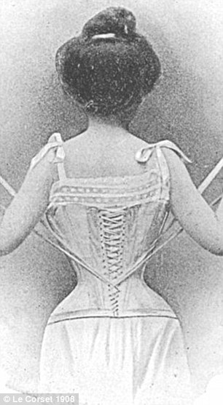
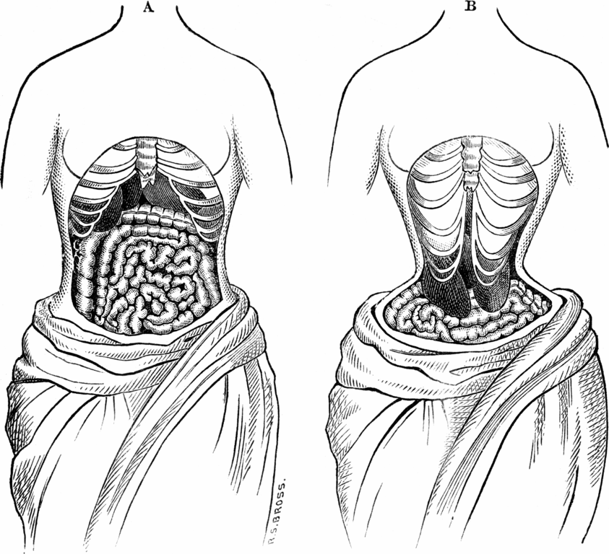

Slide 44
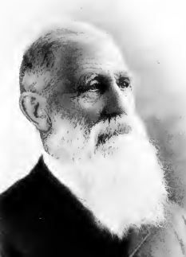
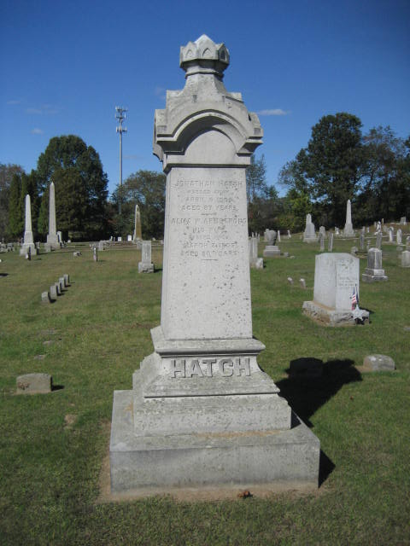
Jonathan Hatch, South Windham, 12 patents

Slide 45
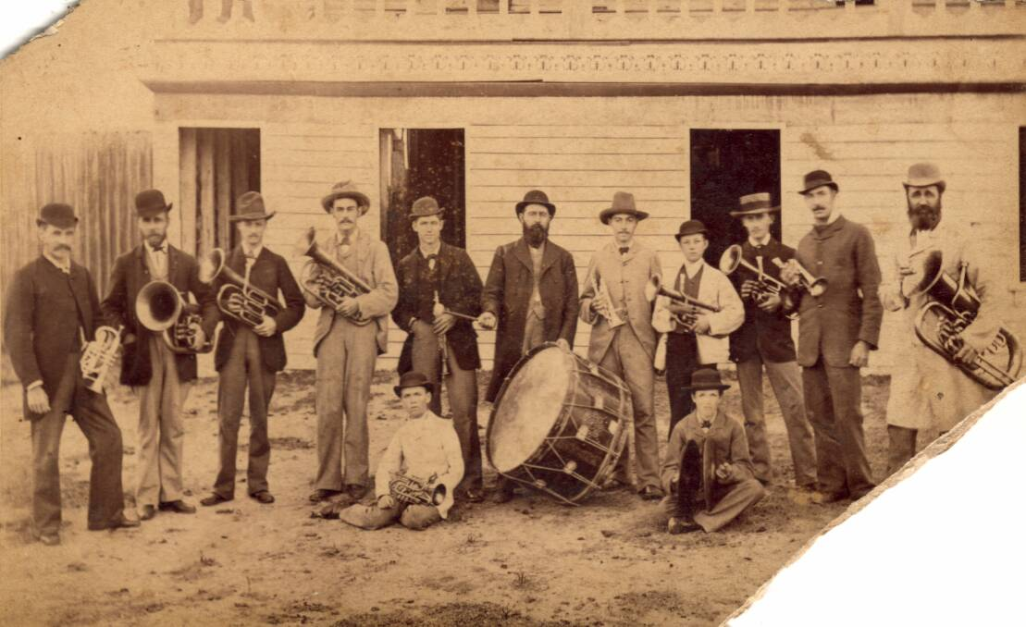

Slide 46
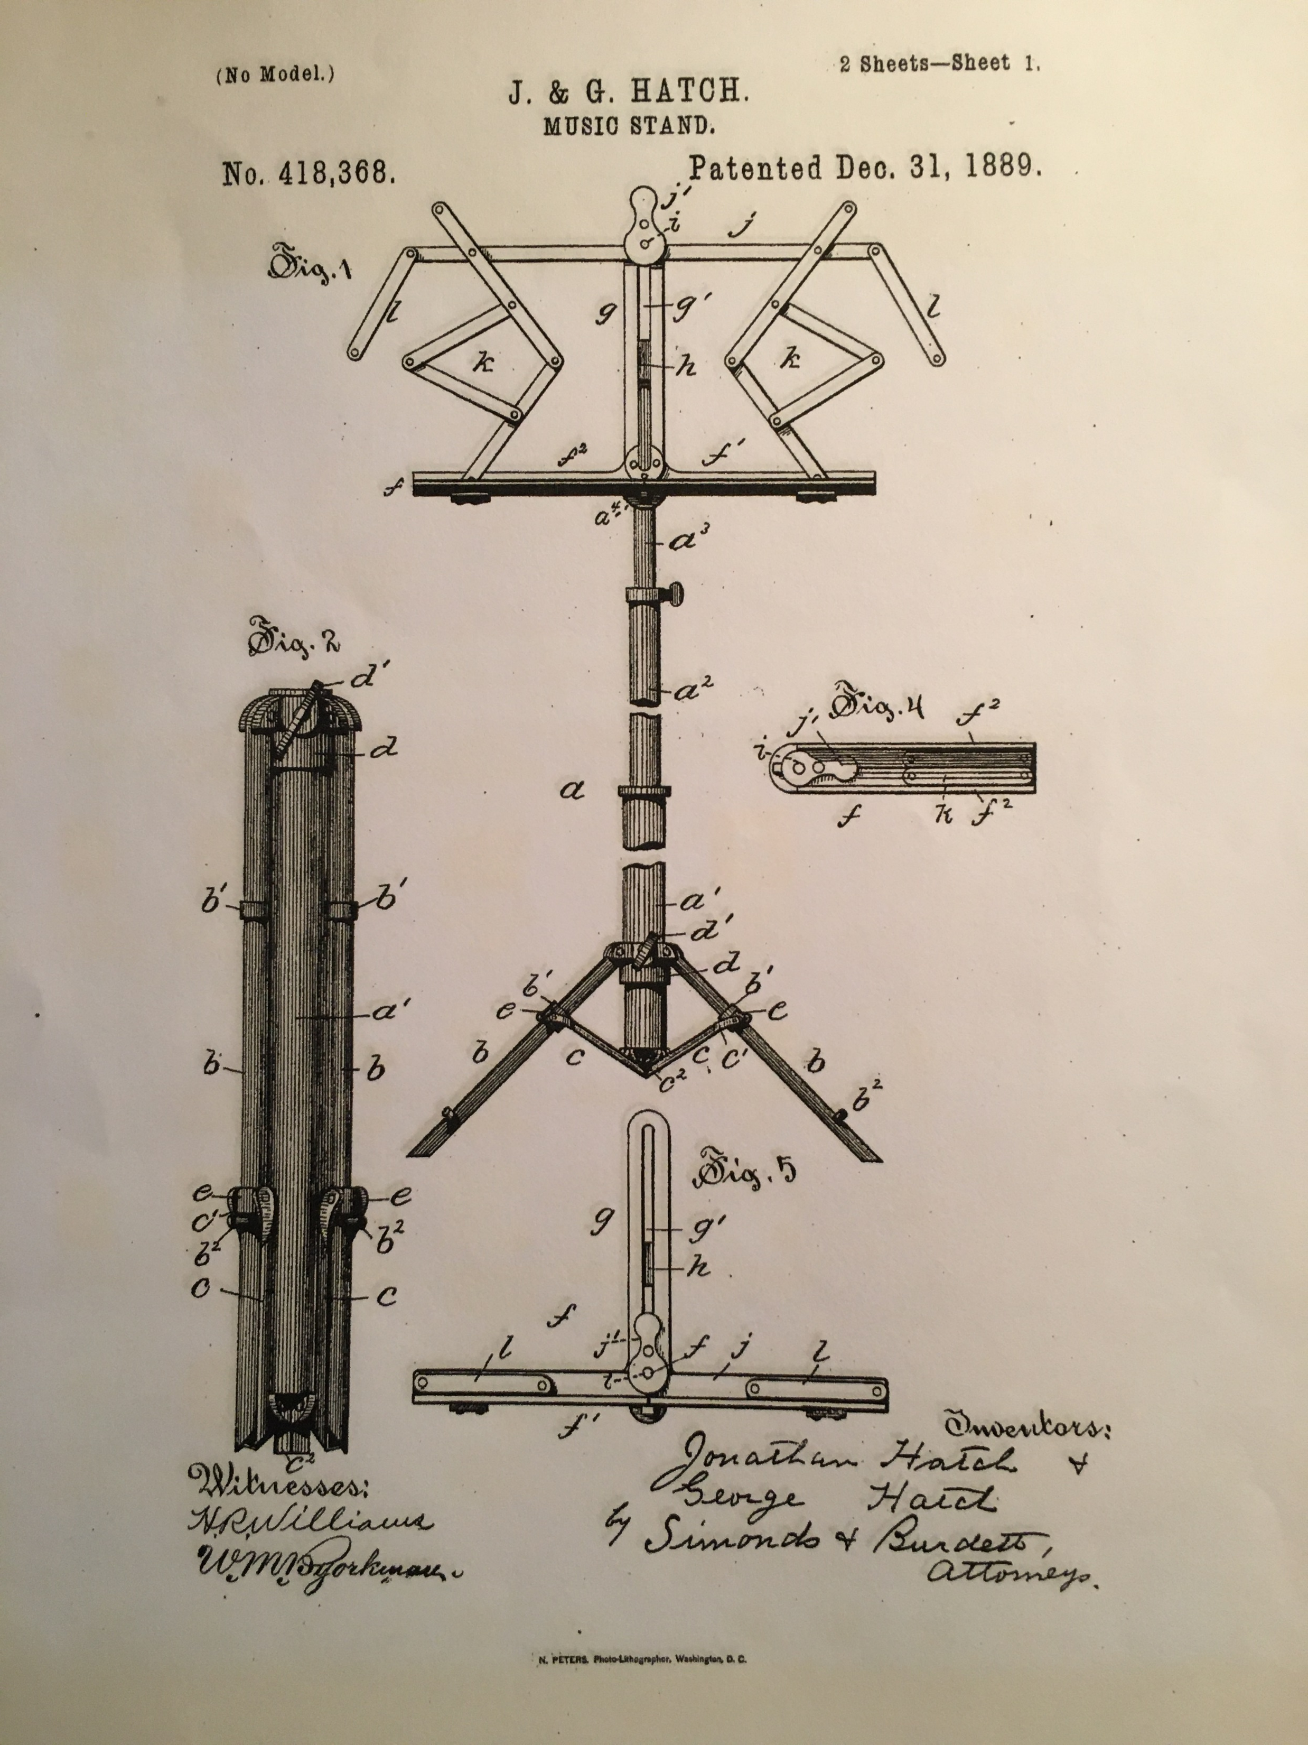
Jonathan Hatch of
South Windham invented and patented the collapsible music stand

