Slide 1
WINDHAM -WILLIMANTIC PATENTS #2
INDUSTRIES:
Jonathan Hatch-Paper making
Robert Binns- Circular Sewing Machine
Jillson and Palmer Cotton (Bale) Opener
Hezekiah Conant- Spool Labeling Machine
Funding provided by the CT Humanities
Inspired by the Connecticut Patent Project at the Connecticut State Library

Slide 3
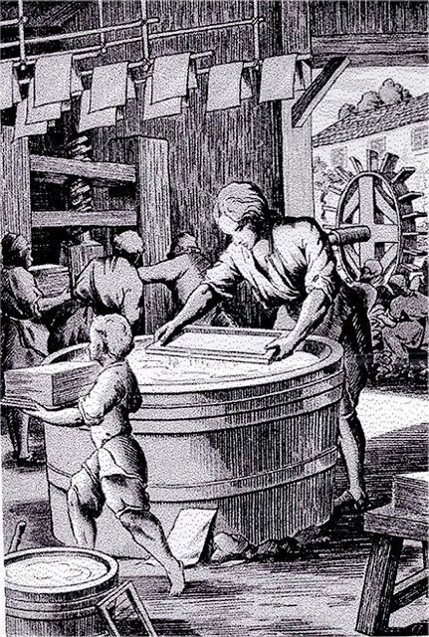
One sheet at a time from wood pulp

Slide 5
A roll of paper from the fourdrinier machine

Slide 6
Smith and Winchester Paper Making

Slide 7
Jonathan Hatch 21 Oct 1817 – 6 Apr 1905 age 87
Born and raised in Lebanon
Worked for Smith and Winchester Paper Making
Married Alma Armstrong, 6 children
Served as Selectman, State Representative
PATENTED MANY IMPROVEMENTS IN PAPER MAKING
Son George gave “Hatch”wing to Windham Hospital

Slide 8
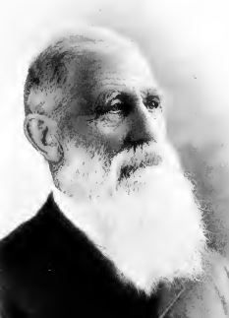
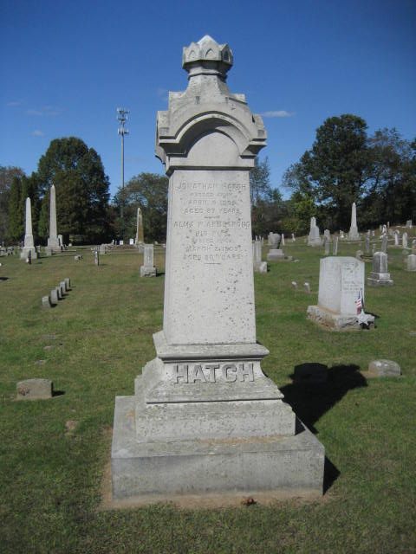
Jonathan Hatch, South Windham, 12 patents

Slide 9
The Radial Thread Buff Company of South Windham was organized by Robert Binns in 1883. The patented buffing wheel was from eight to twelve inches in diameter, made of cotton cloth.

Slide 10
U.S. Patent # 331607 A spiral sewing machine to stitch the buffing wheels.

Slide 12
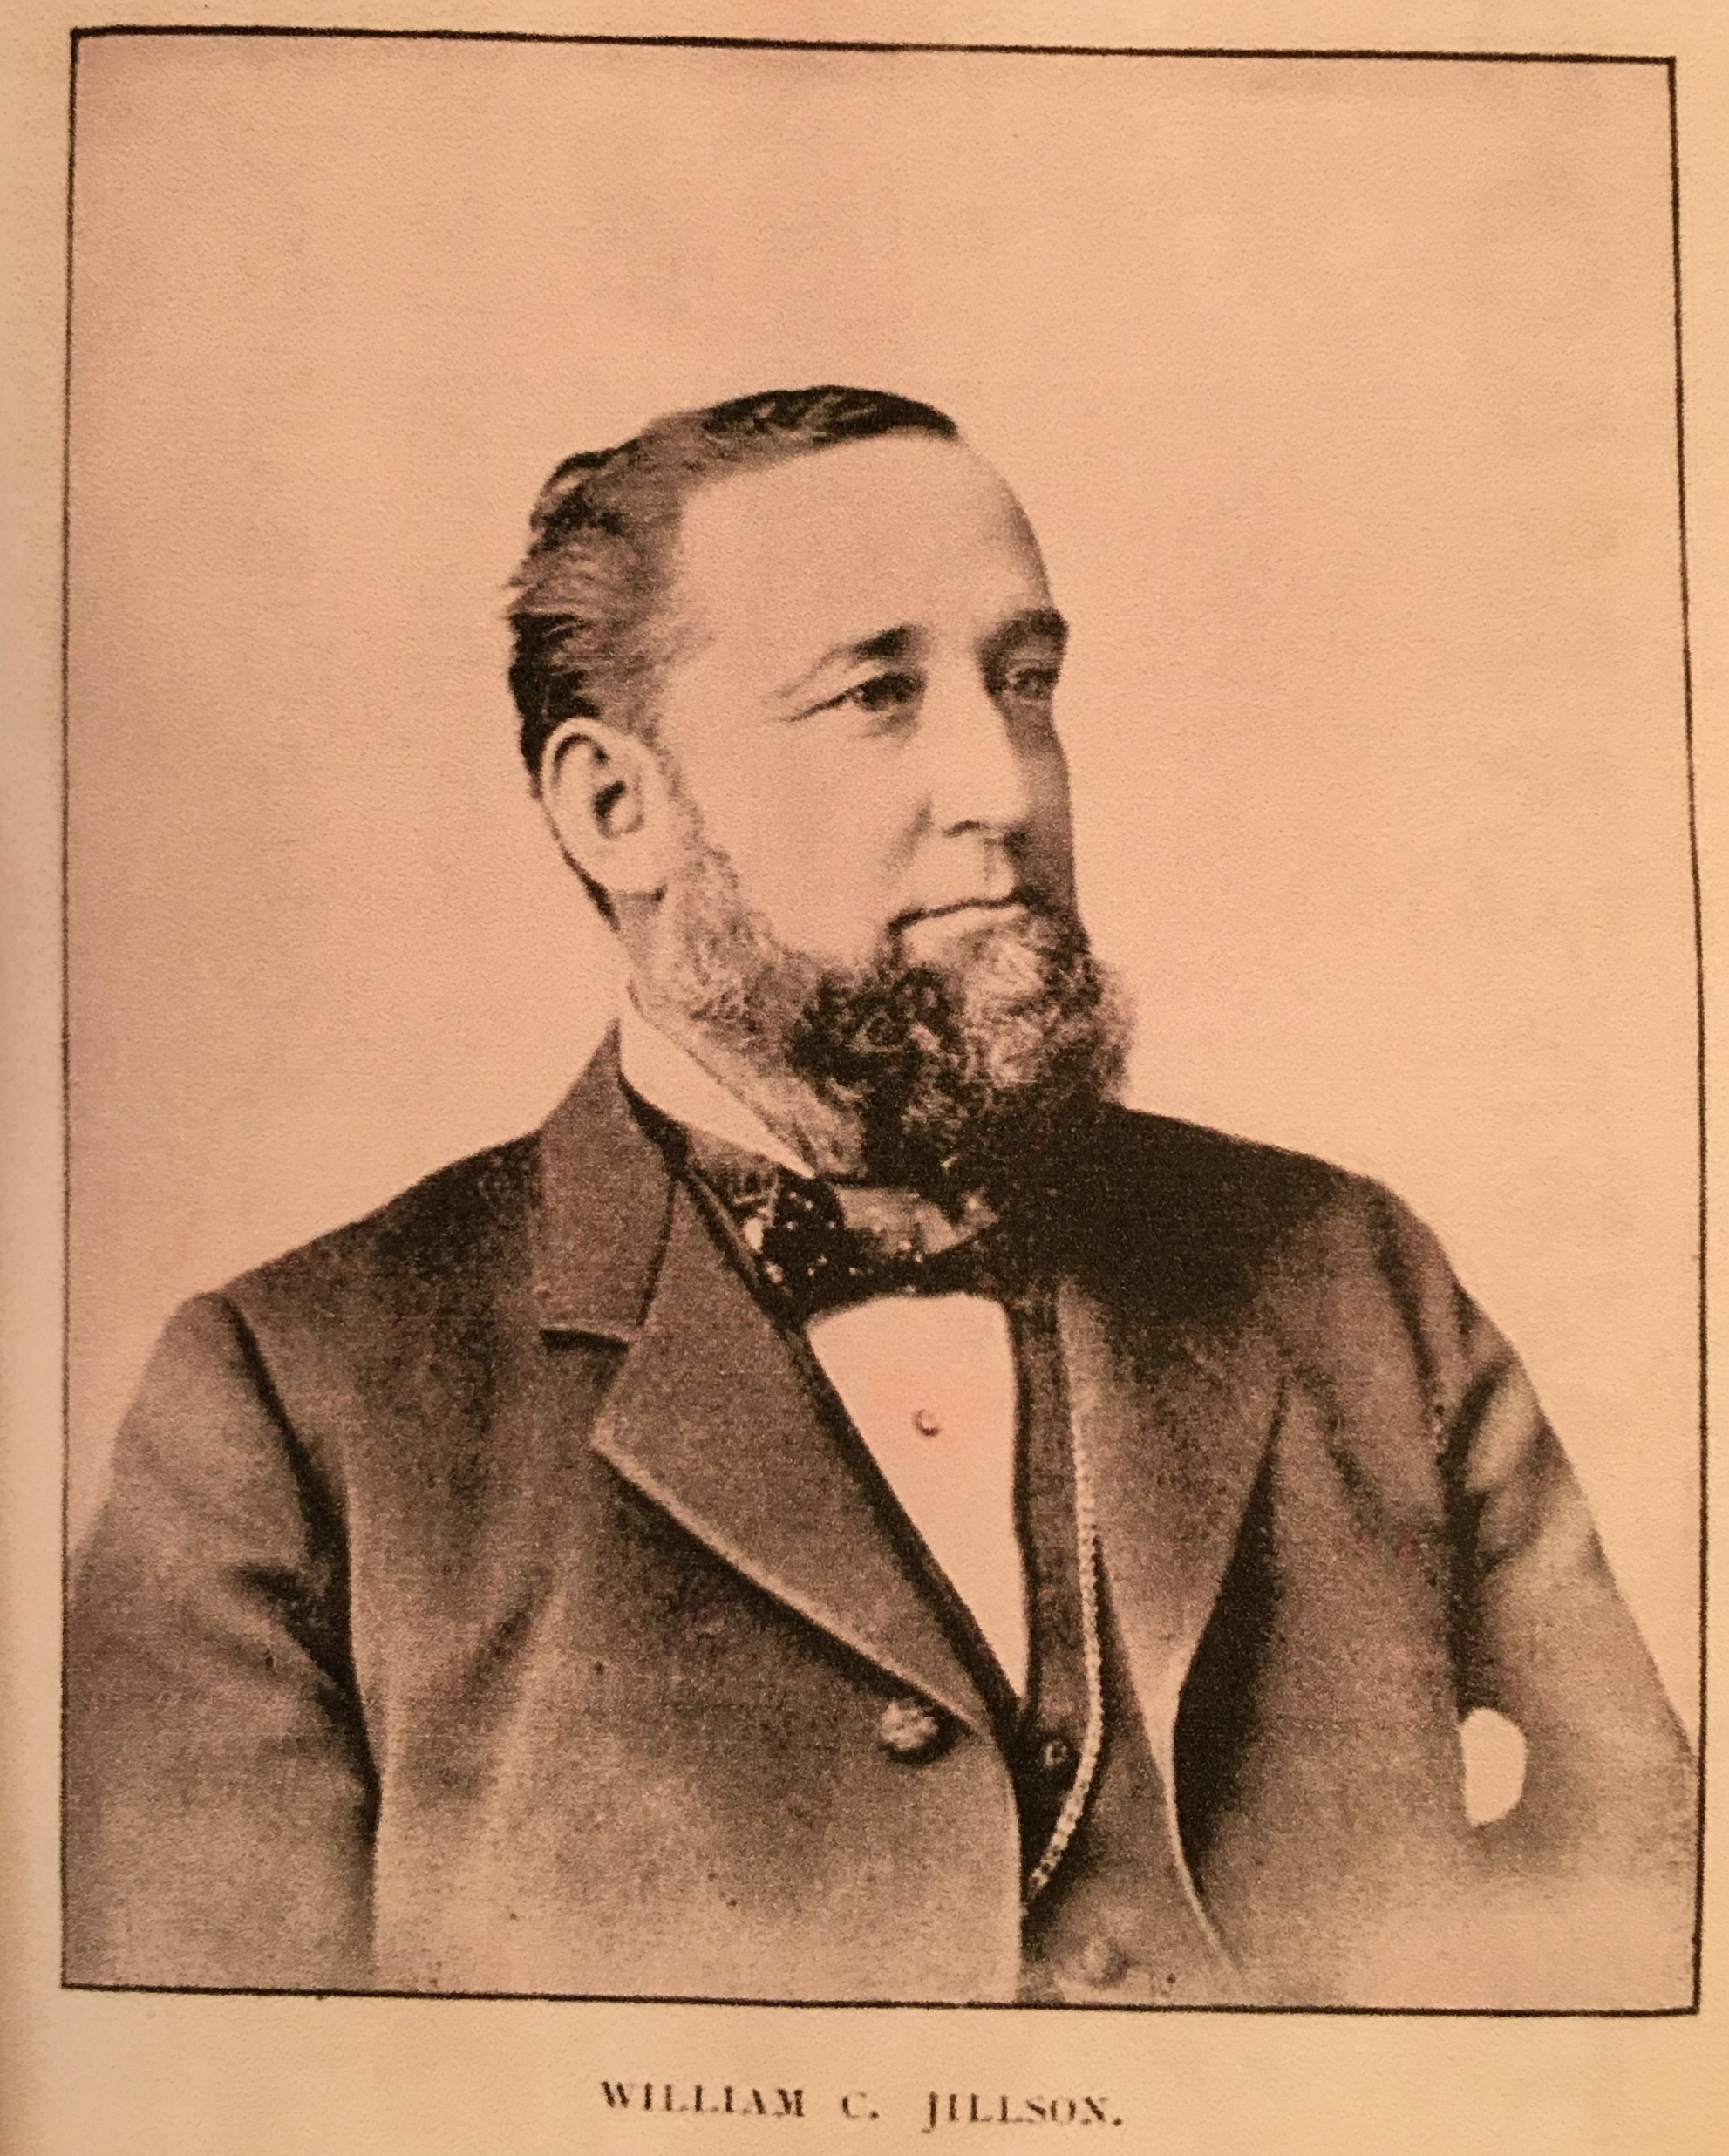
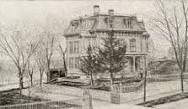
William C. Jillson,
grandson of Asa Jillson
Owner of cotton mills
Bank President
Played Flute
State Representative

Slide 13
Messrs. Jillson & Palmer, the inventors, patentees and proprietors of Jillson & Palmer’s cotton opener, the best machine ever brought out for the purpose (so claimed), reside in Willimantic and manufacture their machines here.

Slide 14
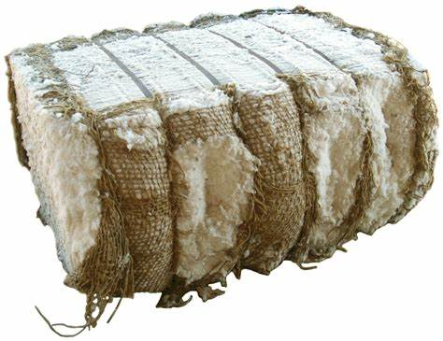
Over 5 feet long about 500 pounds
© 2024 Microsoft
Privacy and Cookies
Legal
Advertise
About our ads
Help
Feedback
Consumer Health Privacy

Slide 15
manufactured in Willimantic and shipped around the world
Could open and clean 60 bales per week

Slide 17
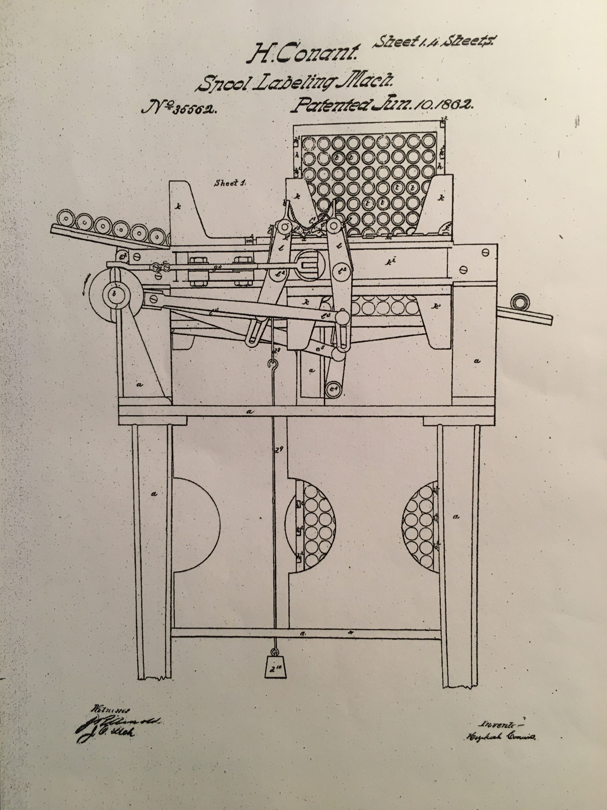

Slide 18
