Slide 1
WINDHAM -WILLIMANTIC PATENTS #1 A Brief History of Patents in the United States
Funding provided by the CT Humanities
Inspired by the Connecticut Patent Project at the Connecticut State Library

Slide 2
Power Point #1
A Brief History of Patents in the United States
Power Point #2 Industries
Jonathan Hatch - Improvements in Fourdrinier Paper Making
Binns - Spiral Sewing Machine
Jillson and Palmer - Cotton Bale Opener
Hezekiah Conant- Spool Labeling Machine
Power Point #3 Patent History, Household
Charles Barrows - Electric Bicycle, Train cars , Mustache Protecter Mug
E. Allen and A. Bradshaw- Moveable, Slidable Games
Catherine Griswold - 30 patents for Corset improvements
Jonathan Hatch - Collapsable Music Stand
Power Point #4 Patents for Food and Retail
H. McCollum – Cracker dough
Dr, George Hamlin - Cider
Ernest Chesbro - Sugar Crusher
Frederick Purington - Lock drawer, Till

Slide 3
The United States Patent Process
Exclusive commercial rights
A patent is a type of intellectual property that gives its owner the legal right to exclude others from making, using, or selling an invention for a limited period of time .
Patent pending- waiting for approval
Patent infringement – violation of patent holder’s rights

Slide 4
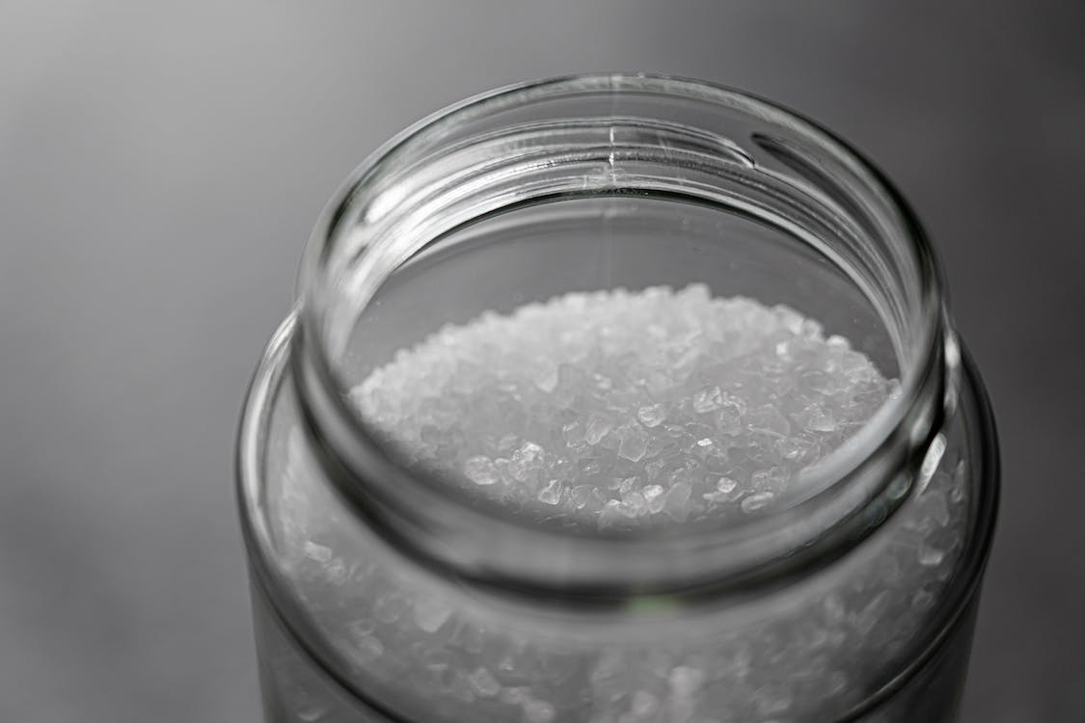
The 1st Patent (unofficially) 1641
The Massachusetts General Court gave Samuel Winslow an exclusive right to utilize a new process of making salt for 10 years.

Slide 5
1718 James Puckle First specification drawing for a patent

Slide 6
The Constitution of the United States, first adopted on September 17, 1787, had a provision for protecting intellectual properties.
.
Article I, Section 8:
"The Congress shall have Power ... To promote the Progress of Science and useful Arts, by securing for limited Times to Authors and Inventors the exclusive Right to their respective Writings and Discoveries."

Slide 7
First patent: granted to Samuel Hopkins, VT for the "making of pot ash and pearl ash by a new apparatus and process". (Potassium salts for fertilizer, lye and saltpeter)

Slide 8
1794 Famous cotton engine by Eli Whitney

Slide 9
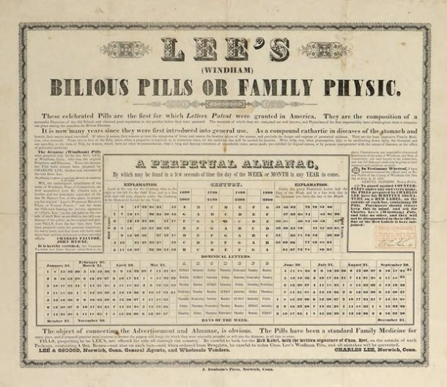
First Medicinal Patent LEE’S WINDHAM BILIOUS PILLS

Slide 10
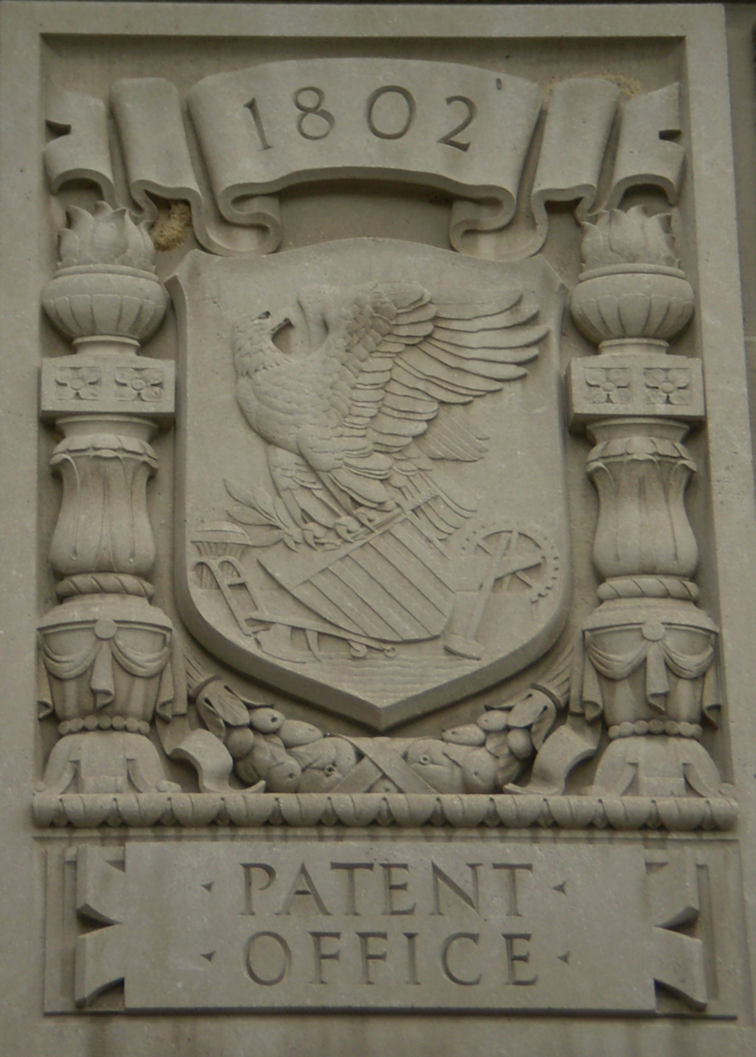
U.S. Patent Office Burned 1836

Slide 12
Hall of Models or the Old Model Museum until 1960s

Slide 14
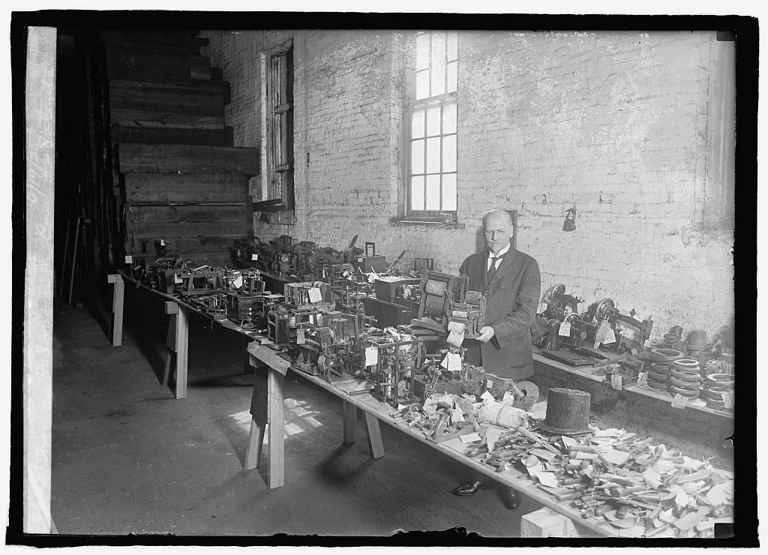

Slide 16
Current Patent Office
five buildings in Alexandria, VA

Slide 17
Current Application Process
Two Types of Patents:
Utility Patent (starts at 699) protects how the invention works
Design Patent (starts at $999) protects how the invention looks
Get help: https://www.allinoneinventions.com/patent-an-idea

Slide 18
