Slide 1
WINDHAM - WILLIMANTIC PATENTS #4
Lee’s Bilious Pills
McCollum’s Cracker Machine
Dr. Hamlin’s Cider Machine
Chesbro’s Sugar Crusher
Purington’s Cash Register Locking Drawer
Funding provided by the CT Humanities
Inspired by the Connecticut Patent Project at the Connecticut State Library

Slide 3
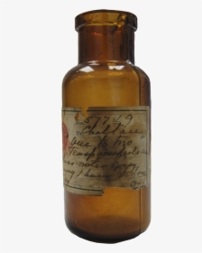
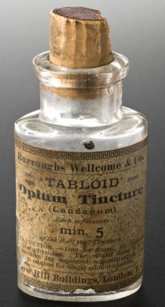
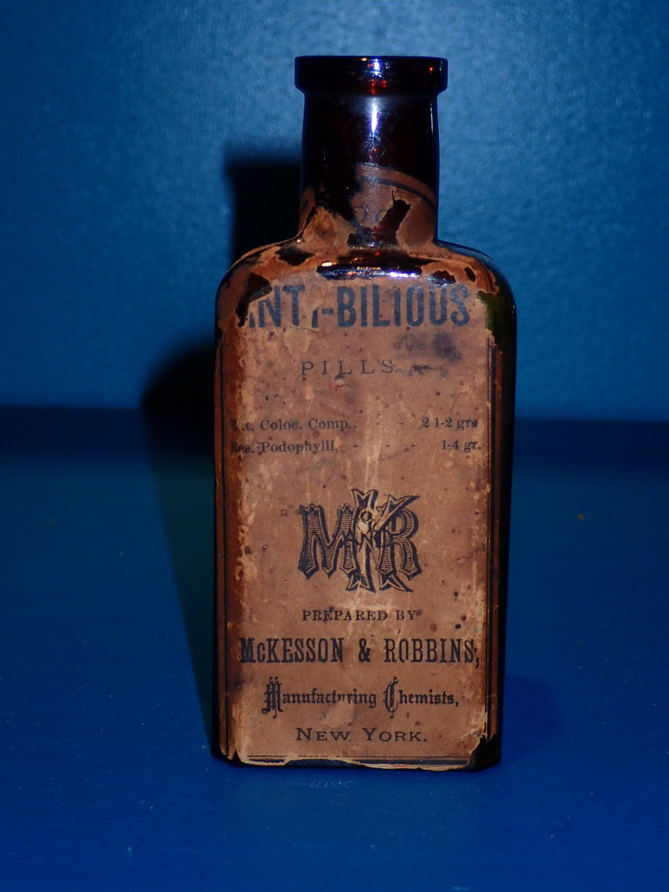
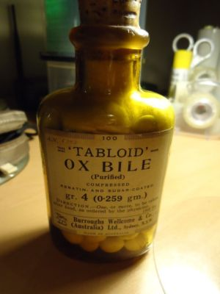

Slide 4
Remedy against overcharge of bile
Remove pains in the head, stomach, bowels
Remove the grips and all obstructions
Help for the gravel, scurvy, cholic, jaundice, dropsy.
Remedy for sea sickness
Effective in preventing yellow fever
Prevent many diseases that seamen are afflicted with

Slide 8
Francis Treadwell and Henry McCollum invented and patented a machine for making the cylindrical strips of dough for the manufacture of crackers.

Slide 9
Dr. George B. Hamlin, Dentist 16 patents 1870 to 1885 Cider Machine Improvement Threshing Kindling Wood Cutter Corn Harvester Wagon Springs ( to prevent wagons from tipping over)

Slide 10
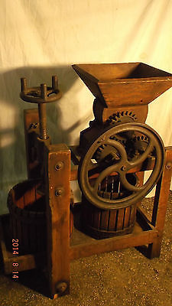

Slide 11
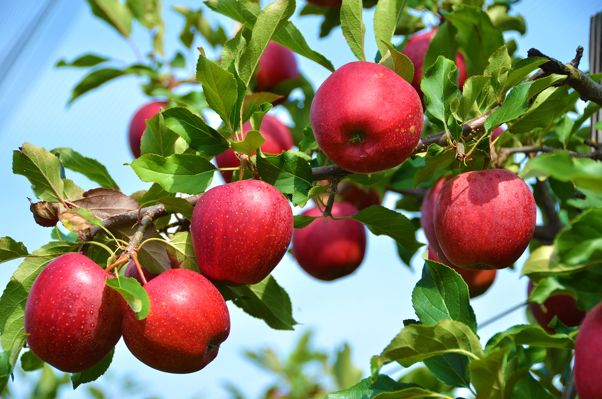
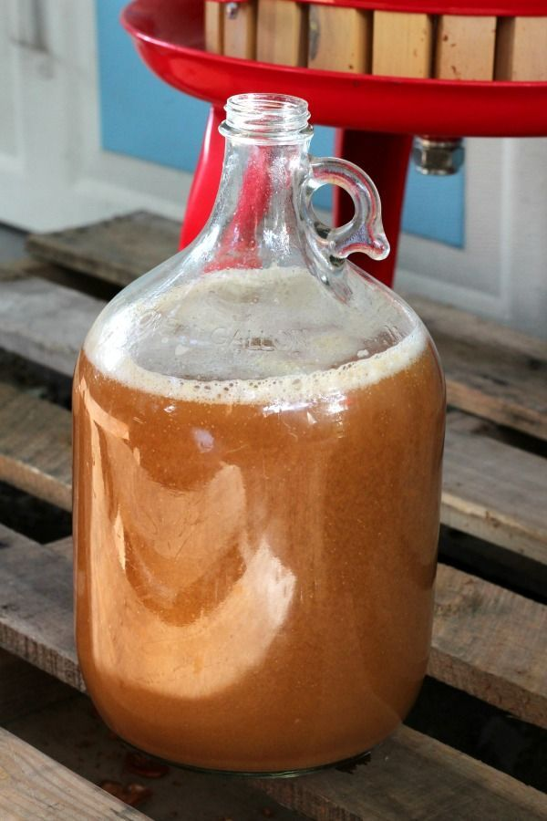

Slide 12
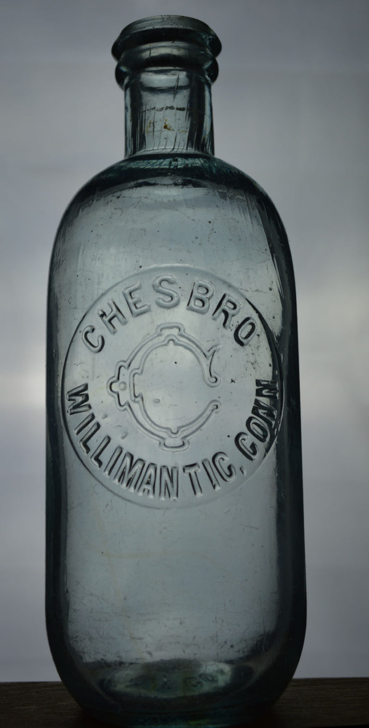
Chesbro’s Pharmacy

Slide 14
Chesbro needed to crush sugar to add it to medicines

Slide 15
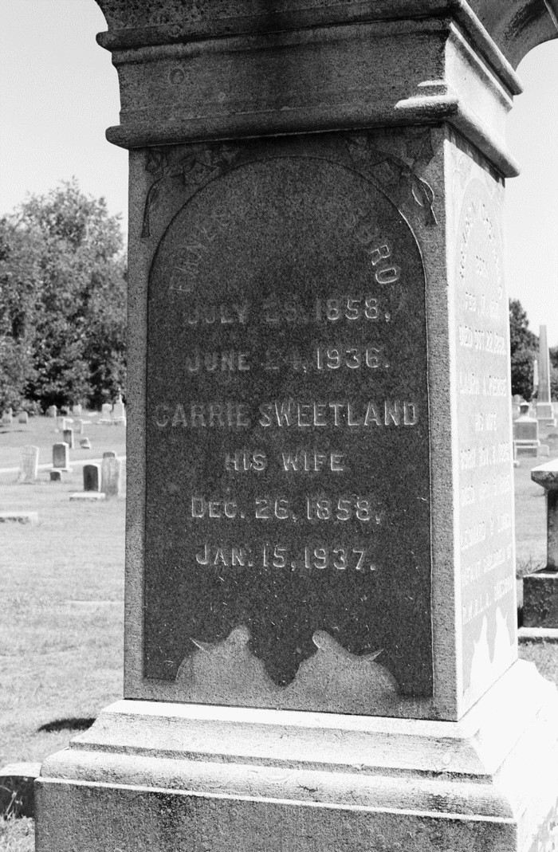
Ernest P. Chesbro 1858- 1936 Chesbro Bros Druggists automotive dealer

Slide 16
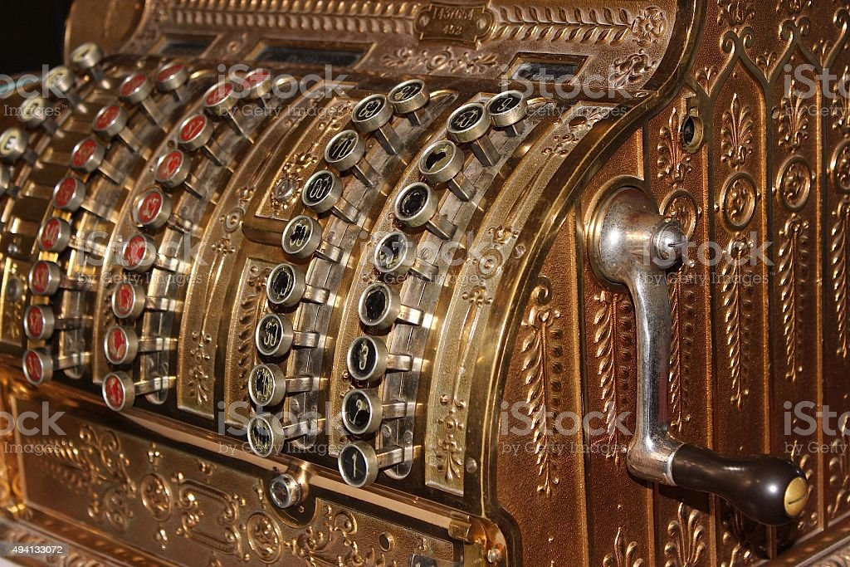

Slide 17
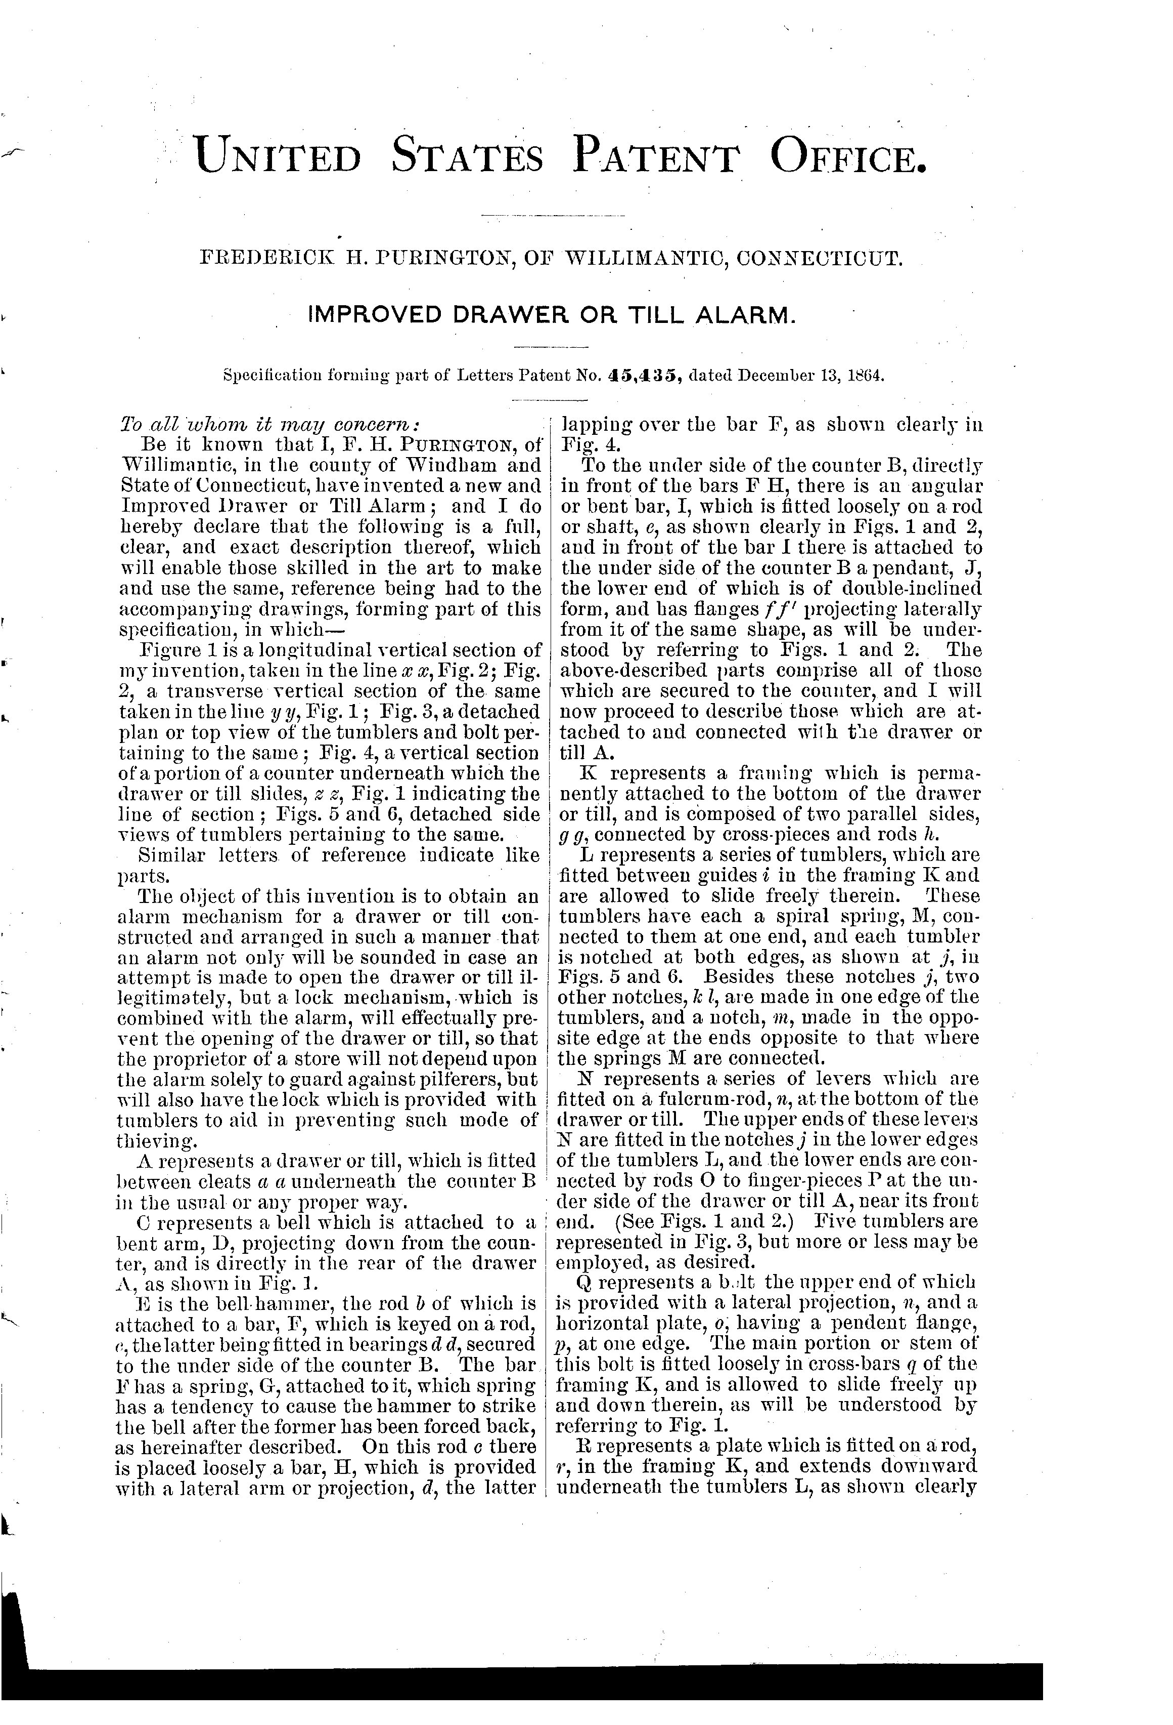
Frederick Purington Till Alarm and Lock

Slide 18
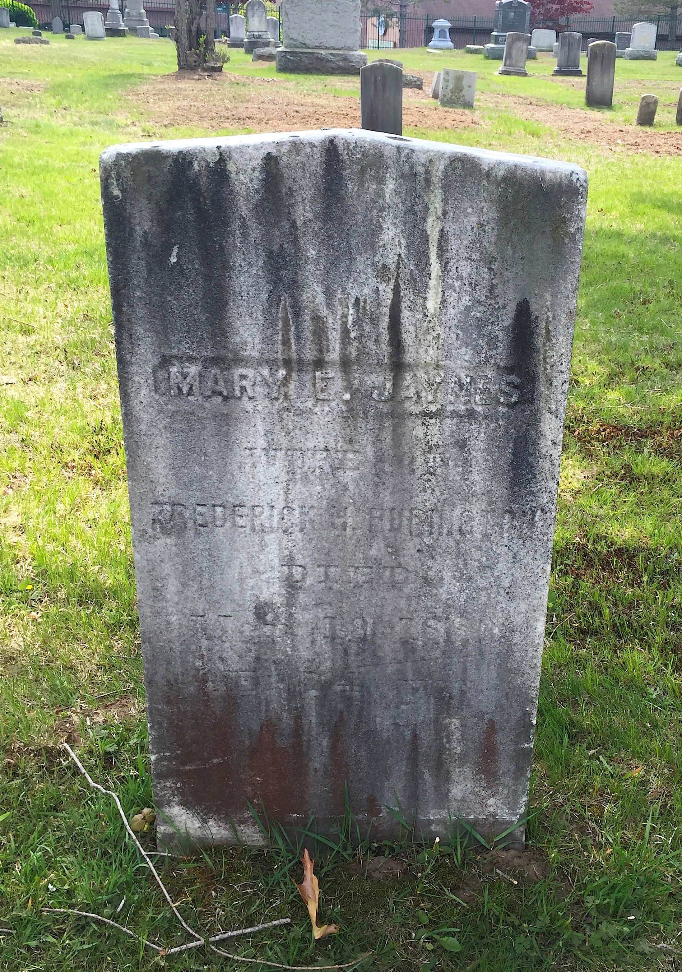
Frederick Purington 1800-1865 Mary Purington 1805 -1880 Old Willimantic Cemetery

